Slide 1
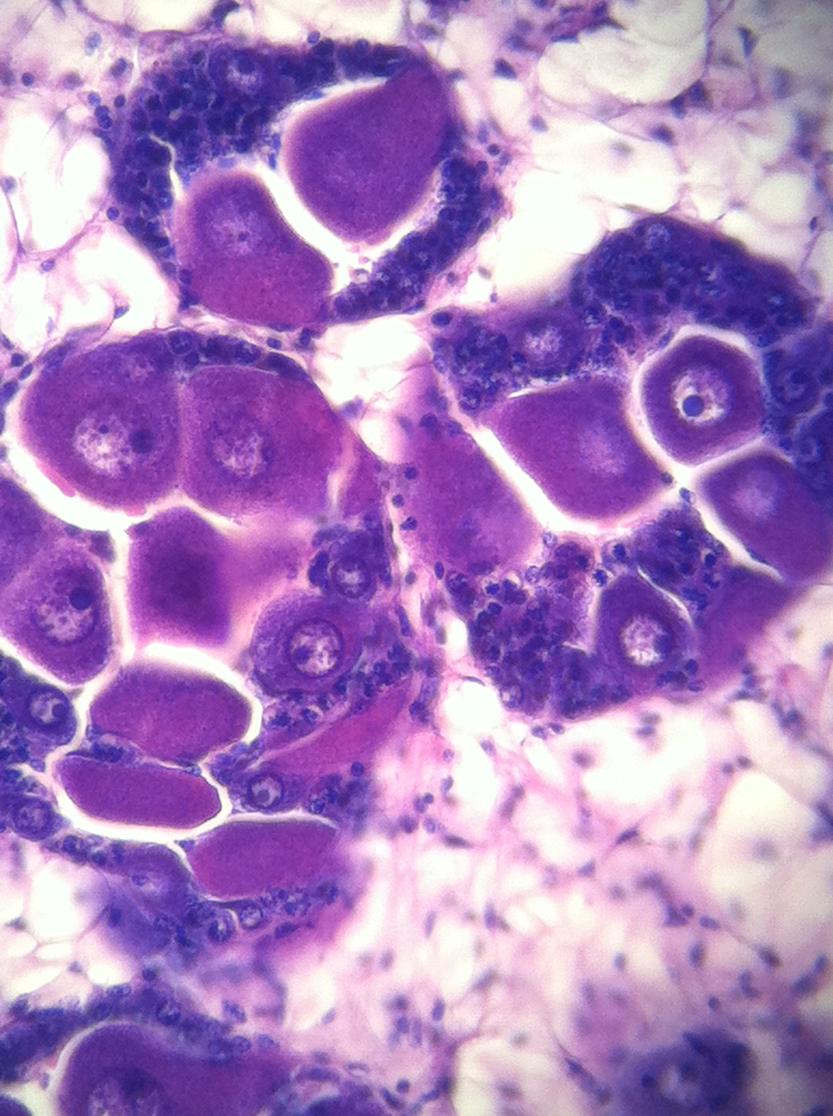
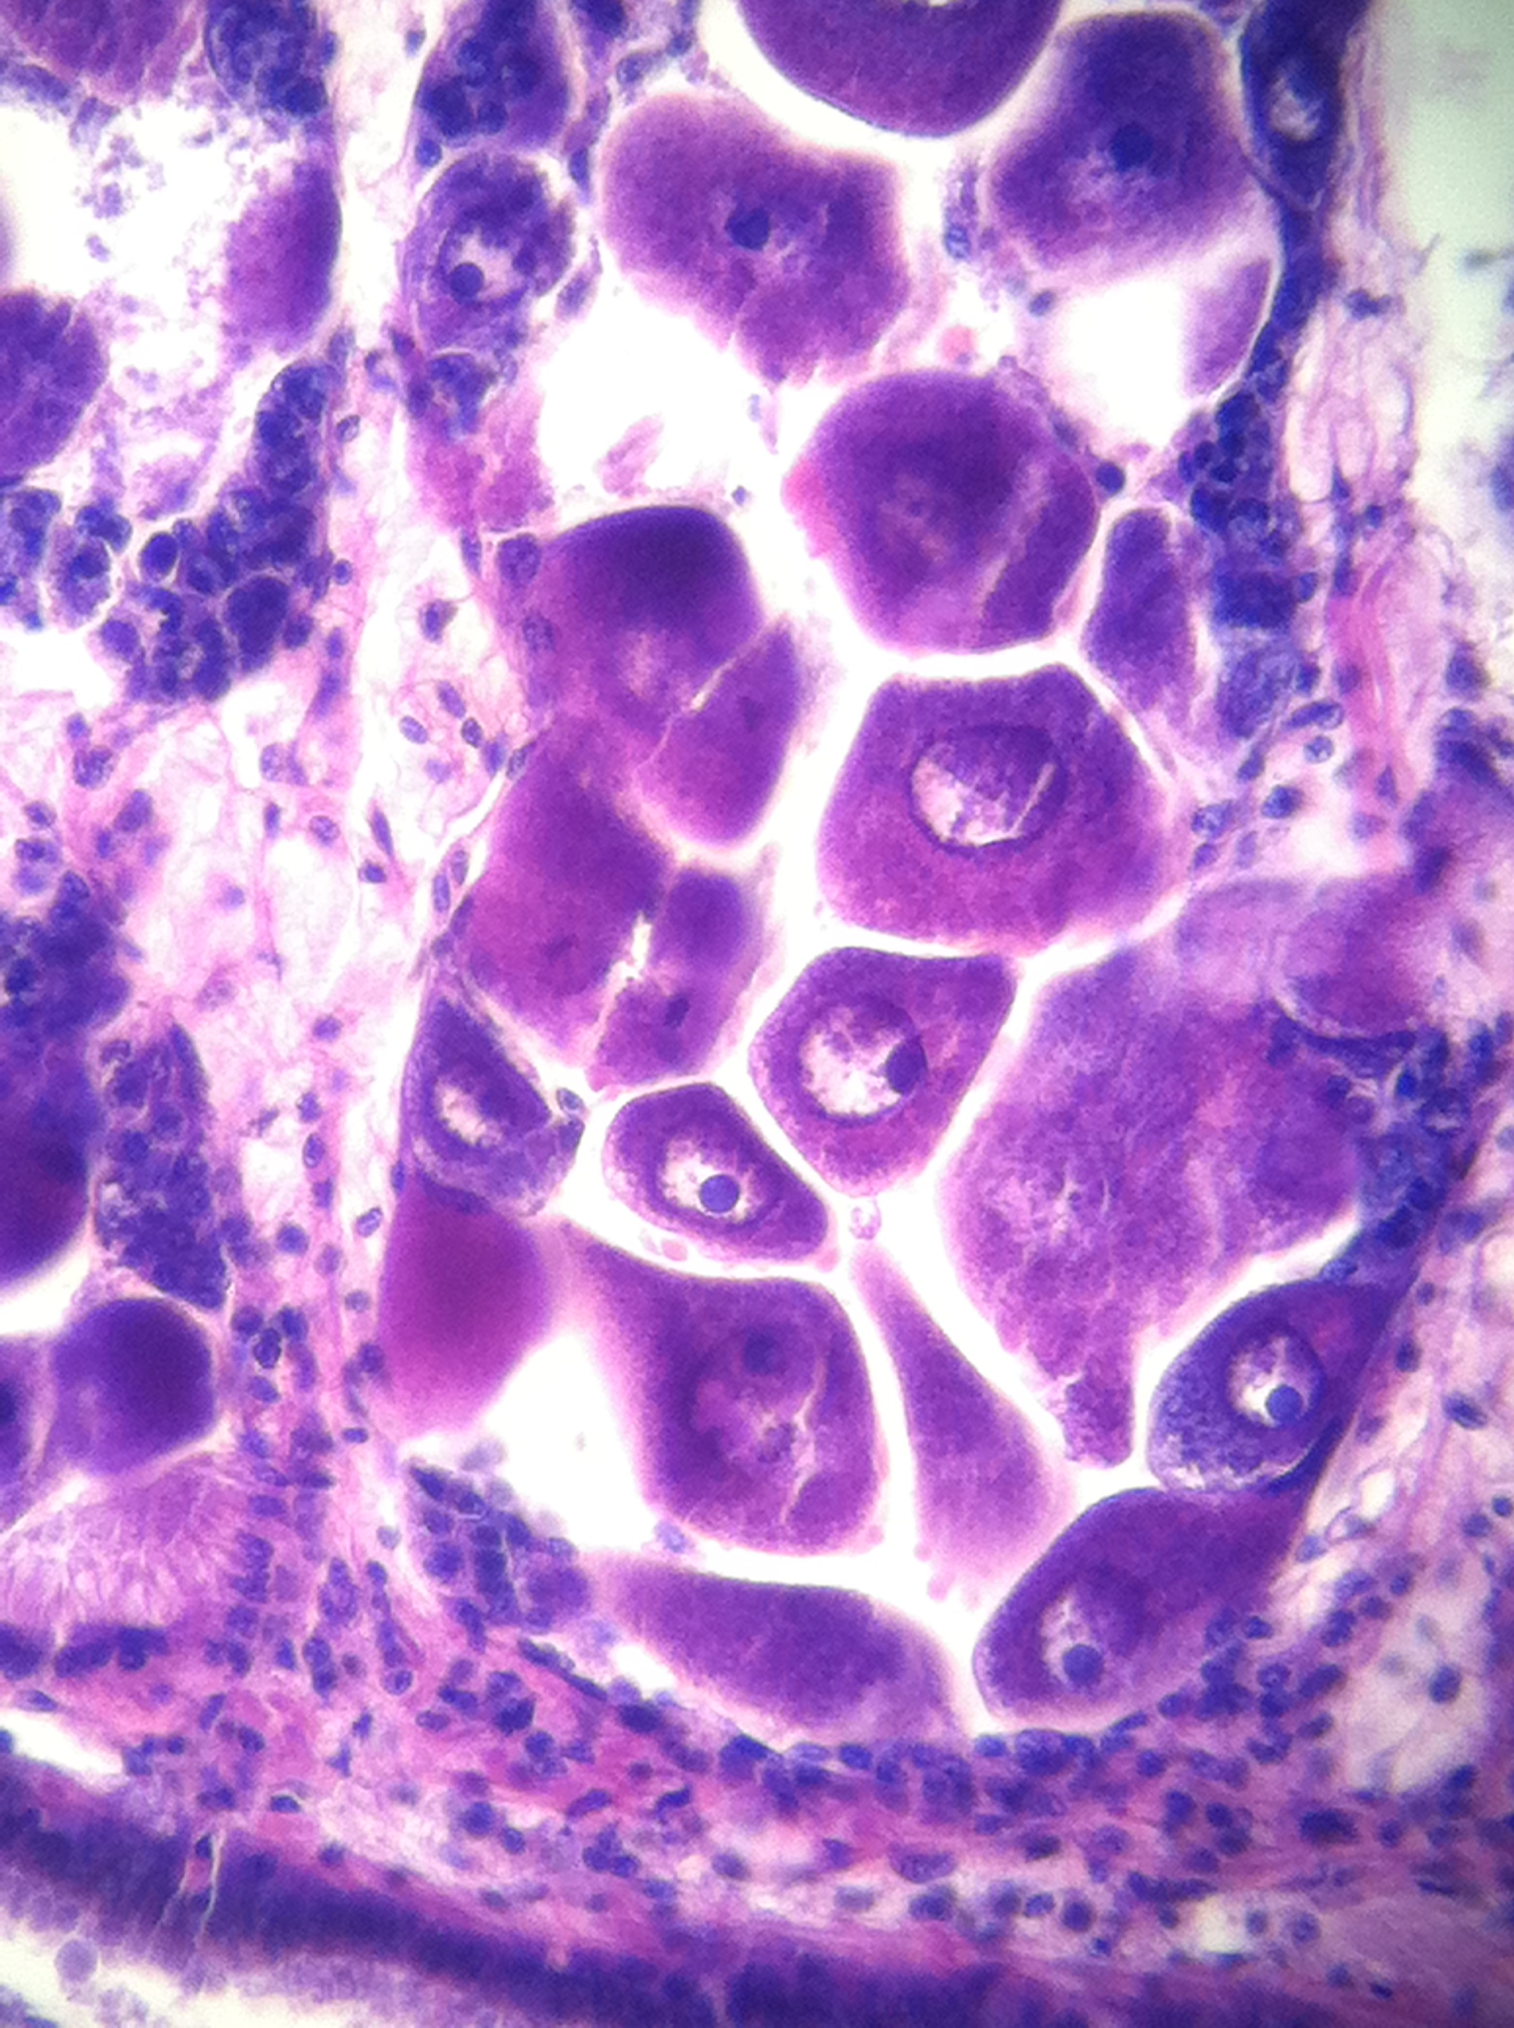
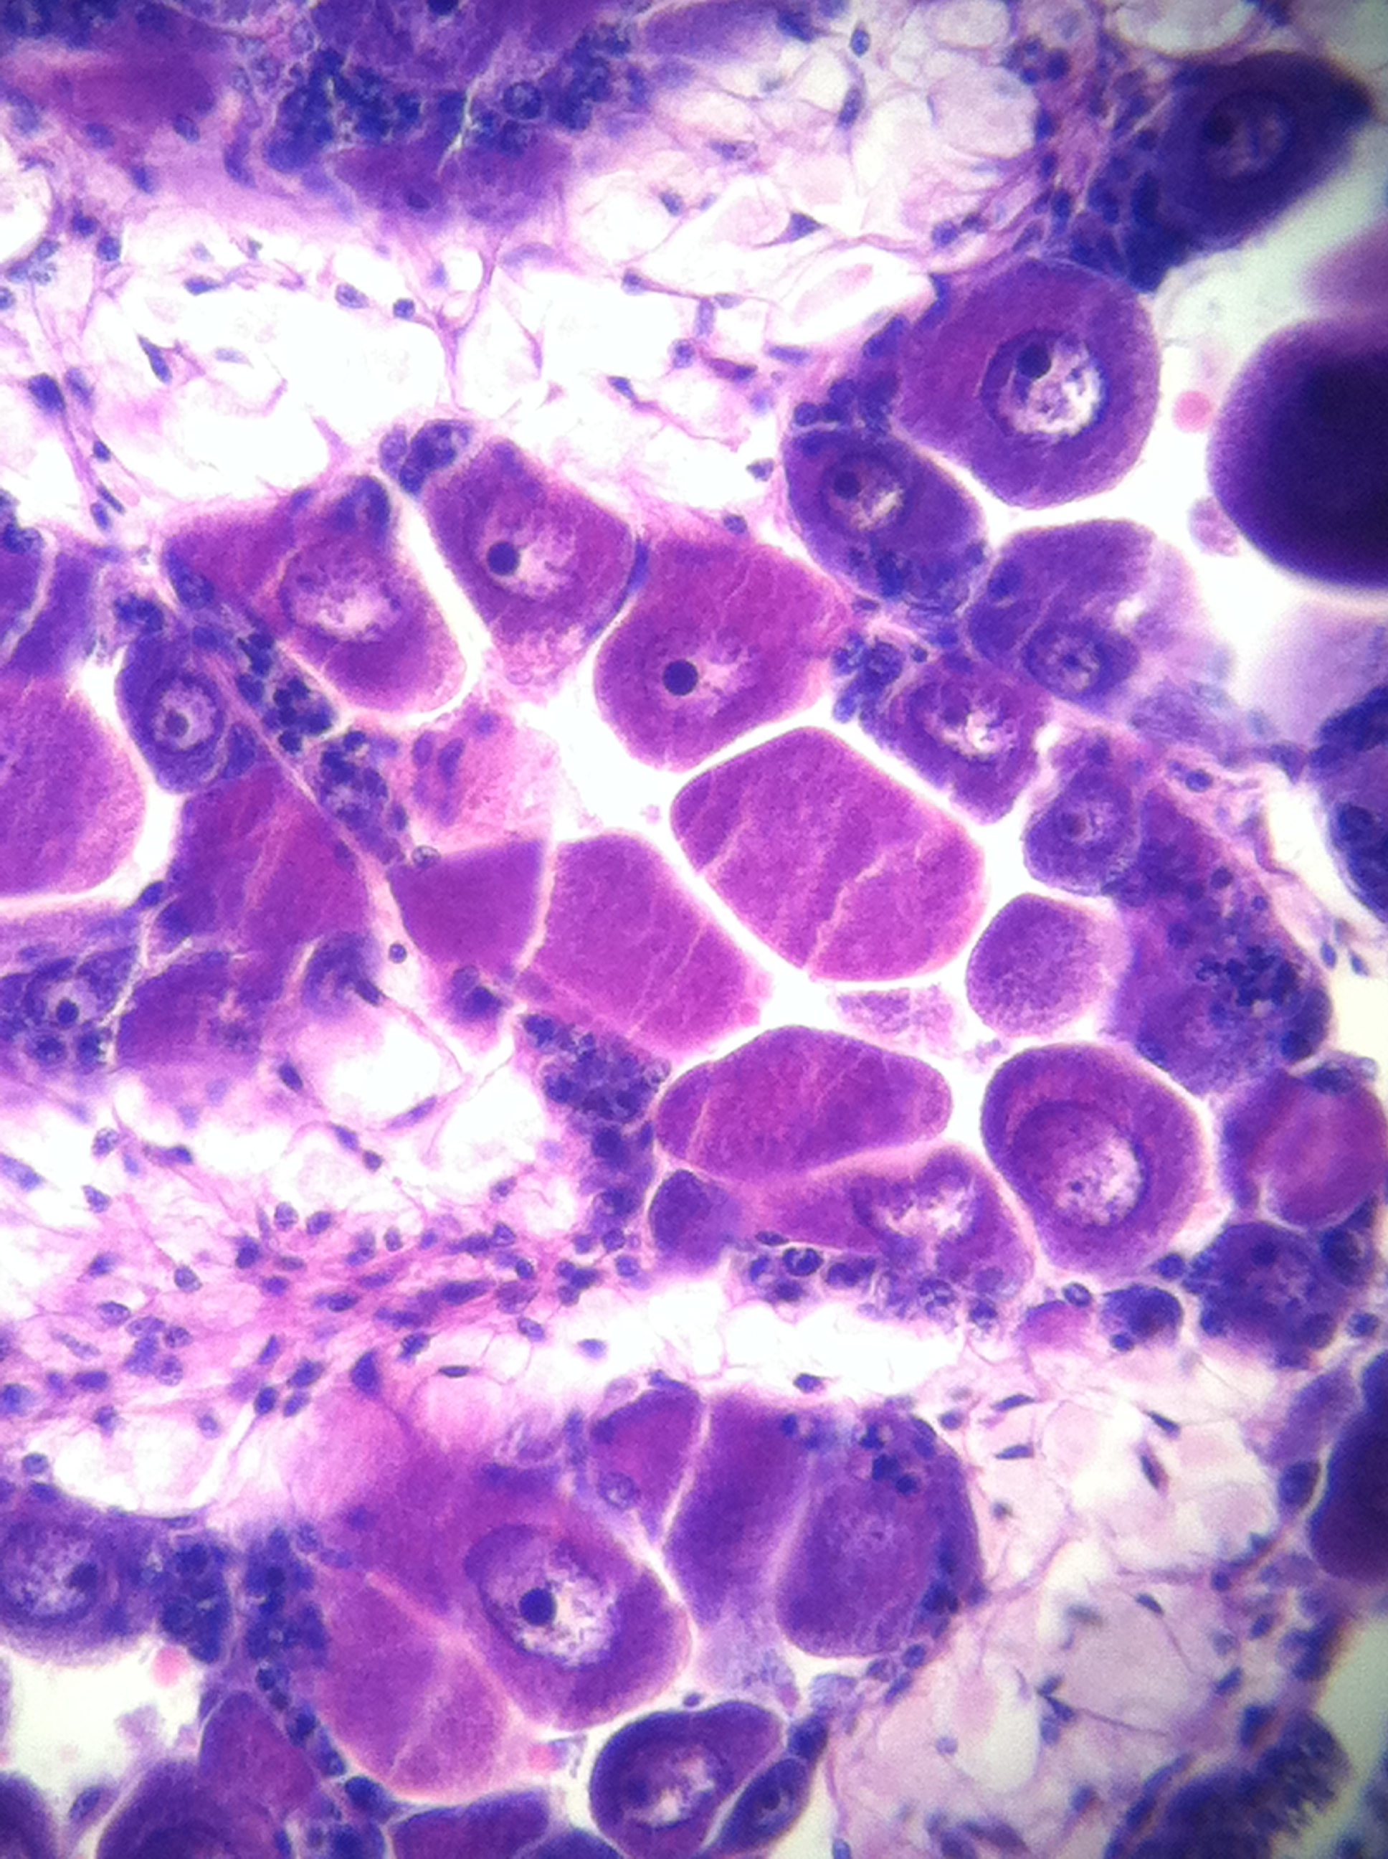
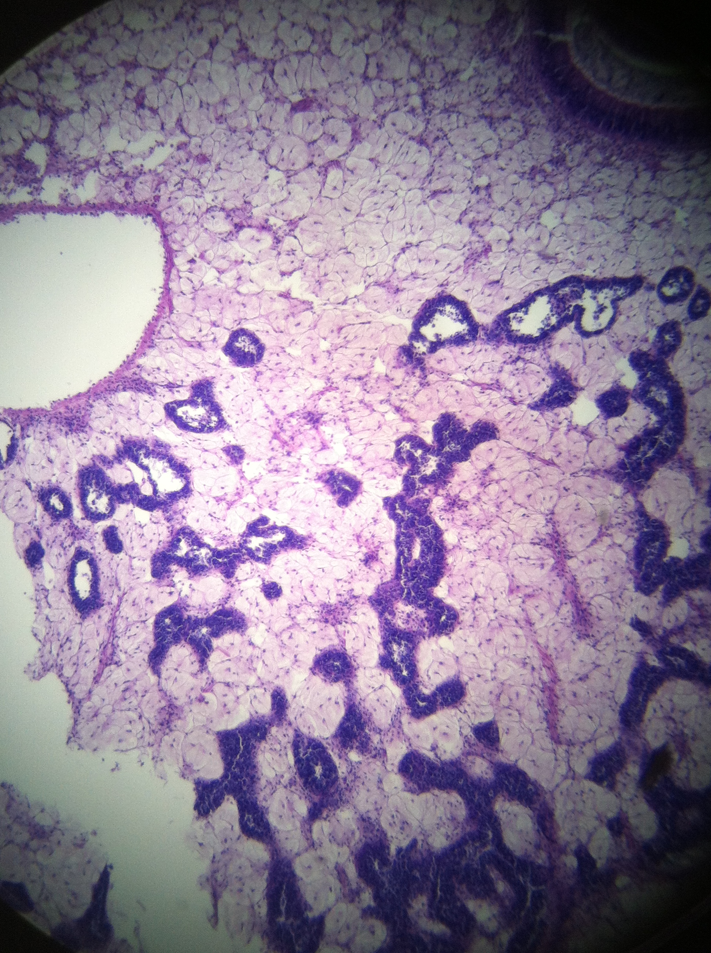
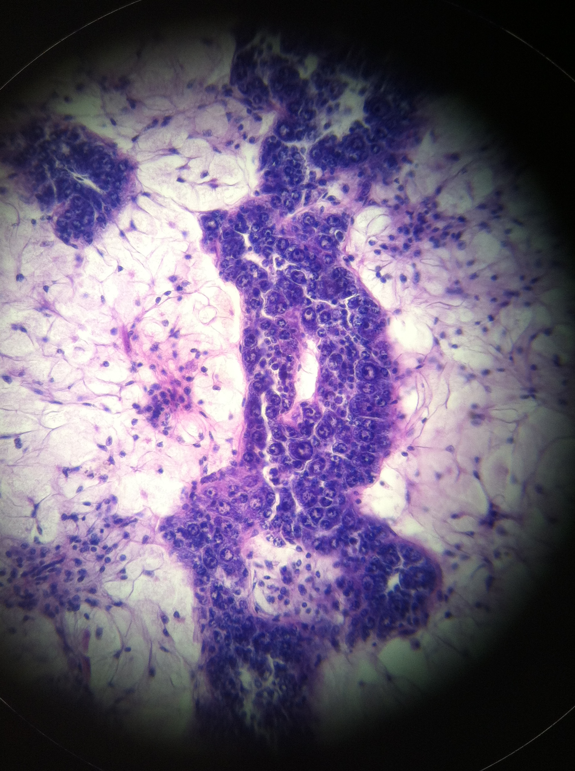
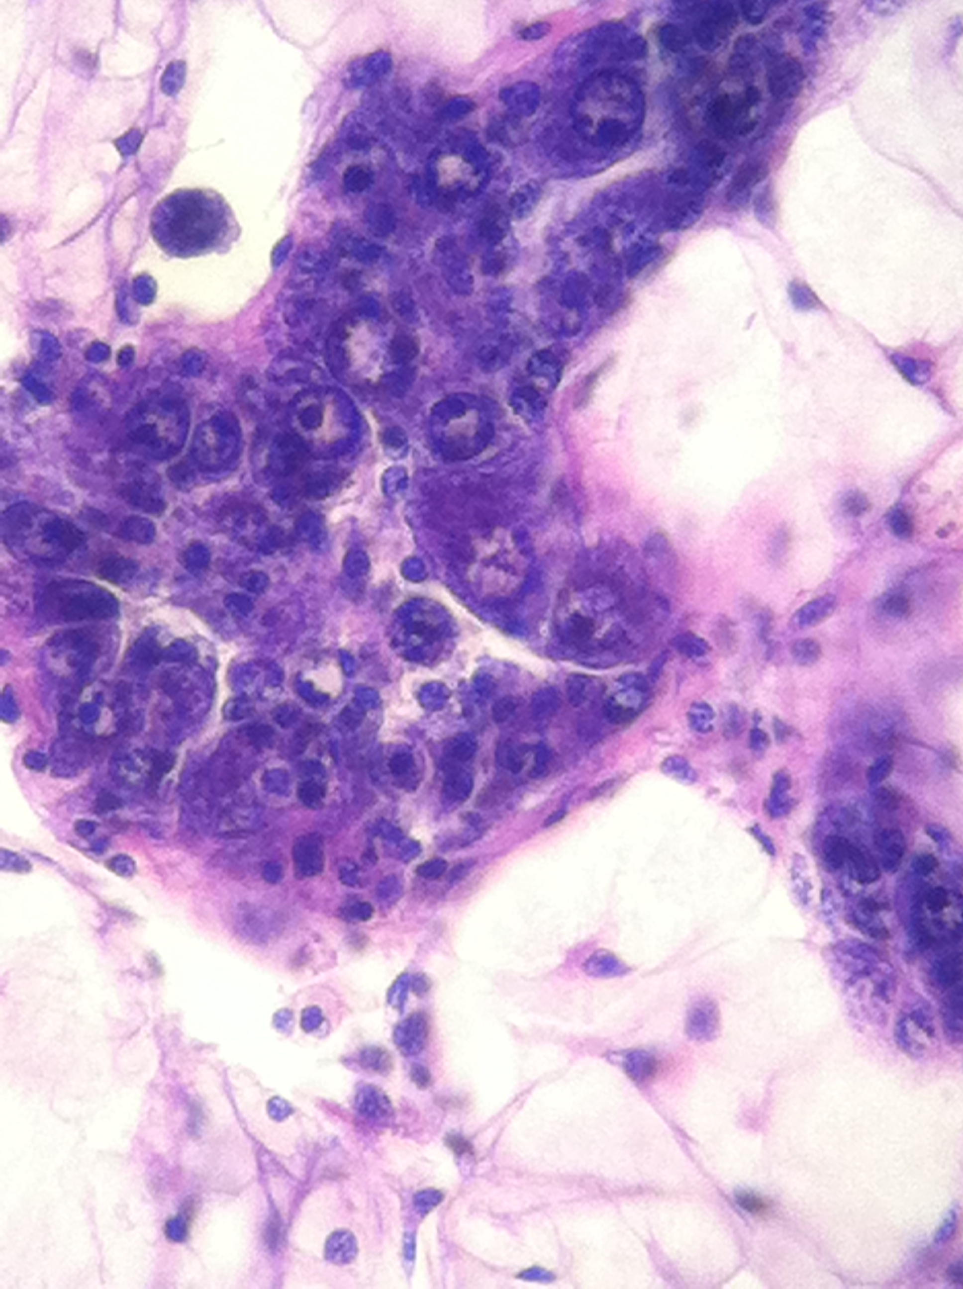
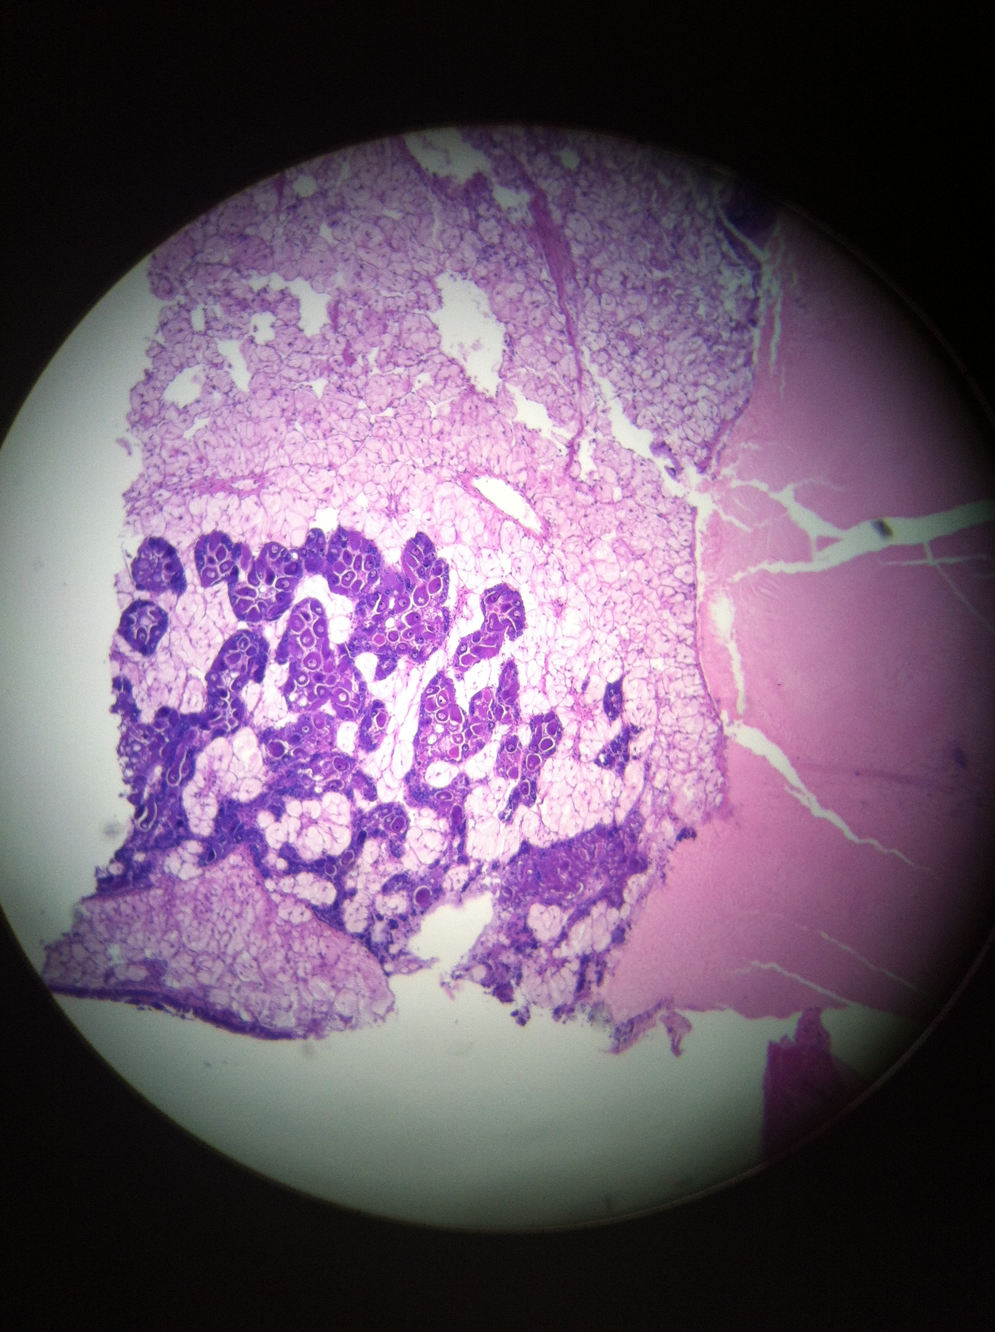
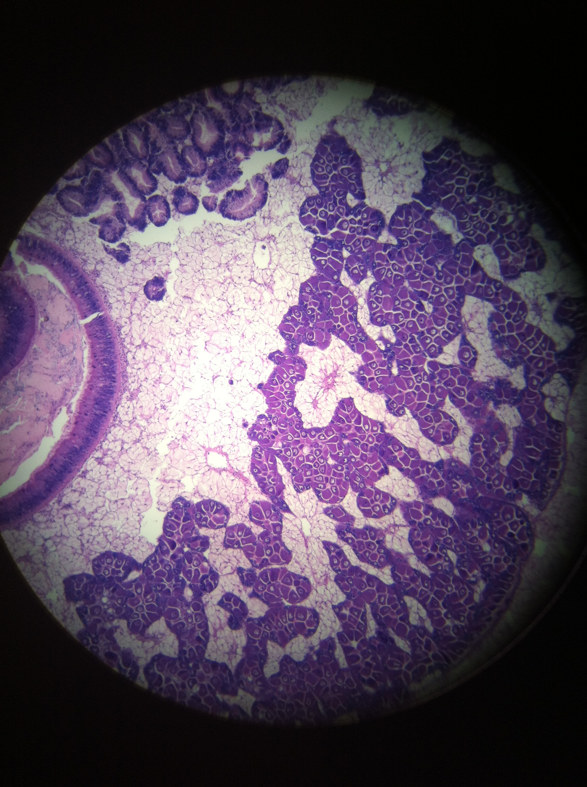
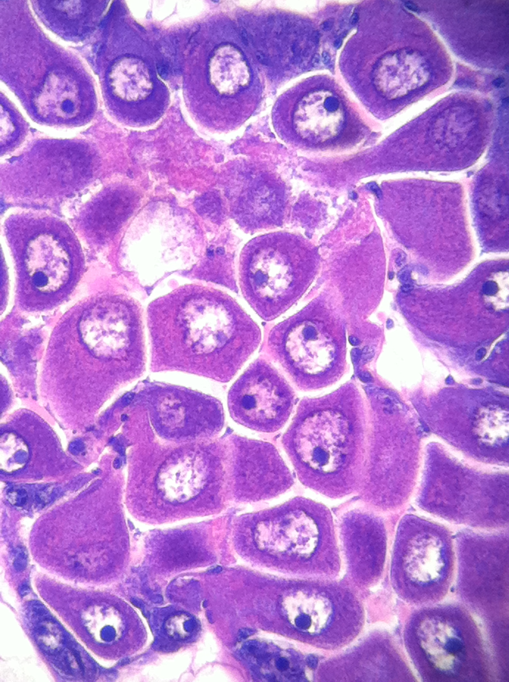
R385 - female
Stage 2 (late developing)
free and attached oocytes
oogonia present on follicle wall
R371 - female
Stage 1 (early developing)
lots of connective tissue
oogonia present on follicle wall, but no oocytes present
R861 - female
Stage 2 (late developing)
oocytes present in center of follicles
maybe bordering on stage 3, but still a lot of connective tissue

Slide 2
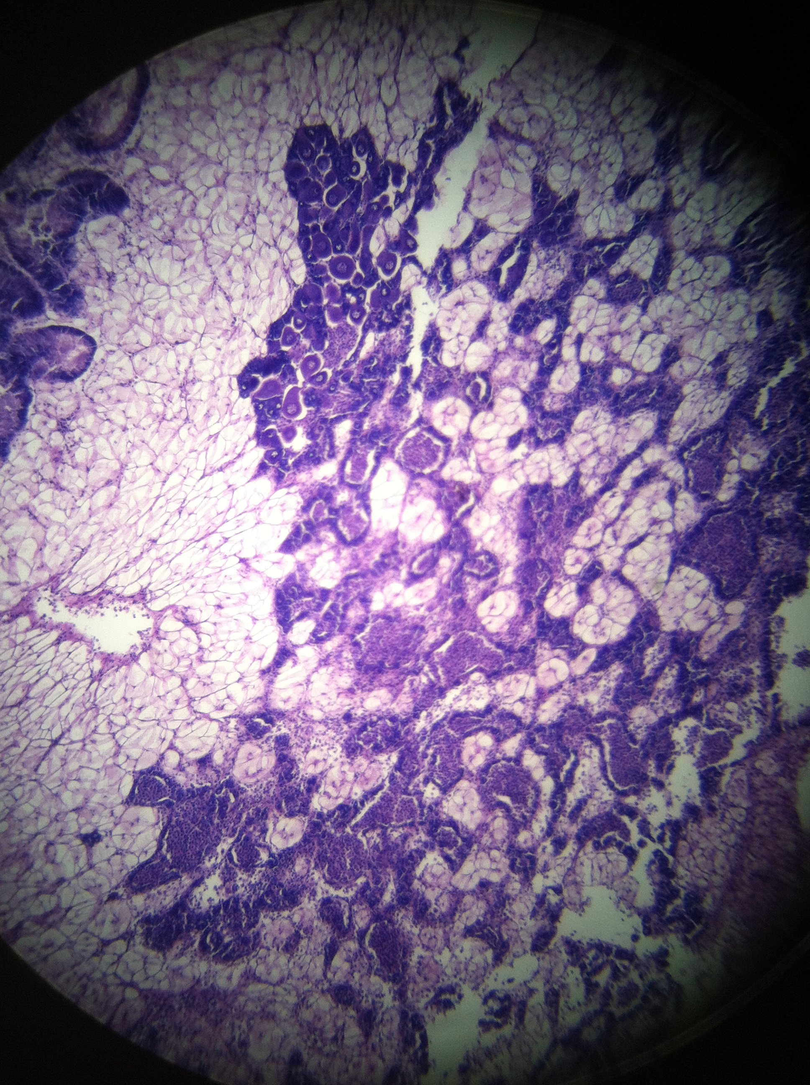
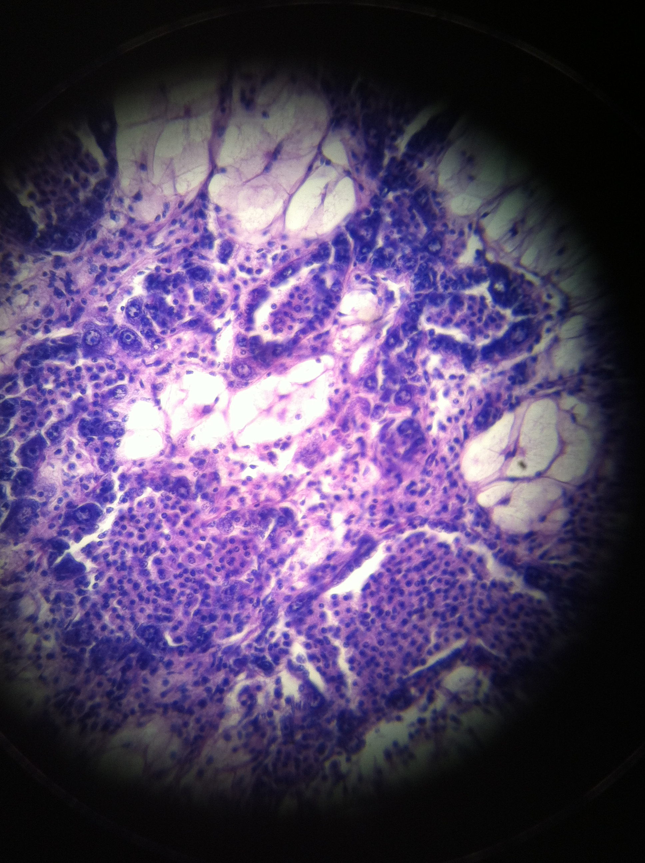
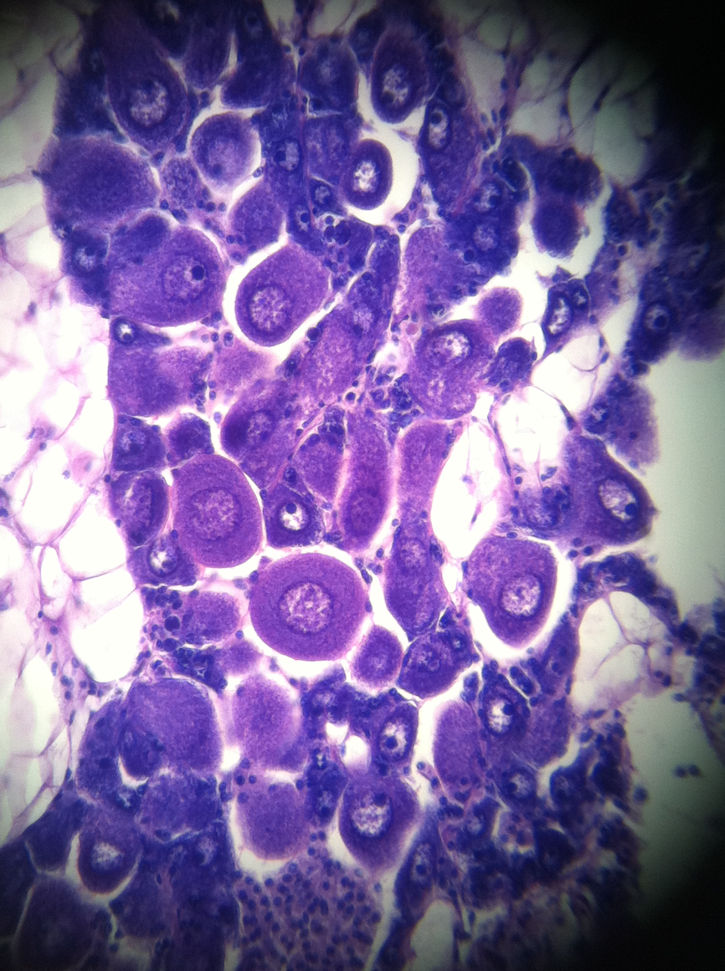
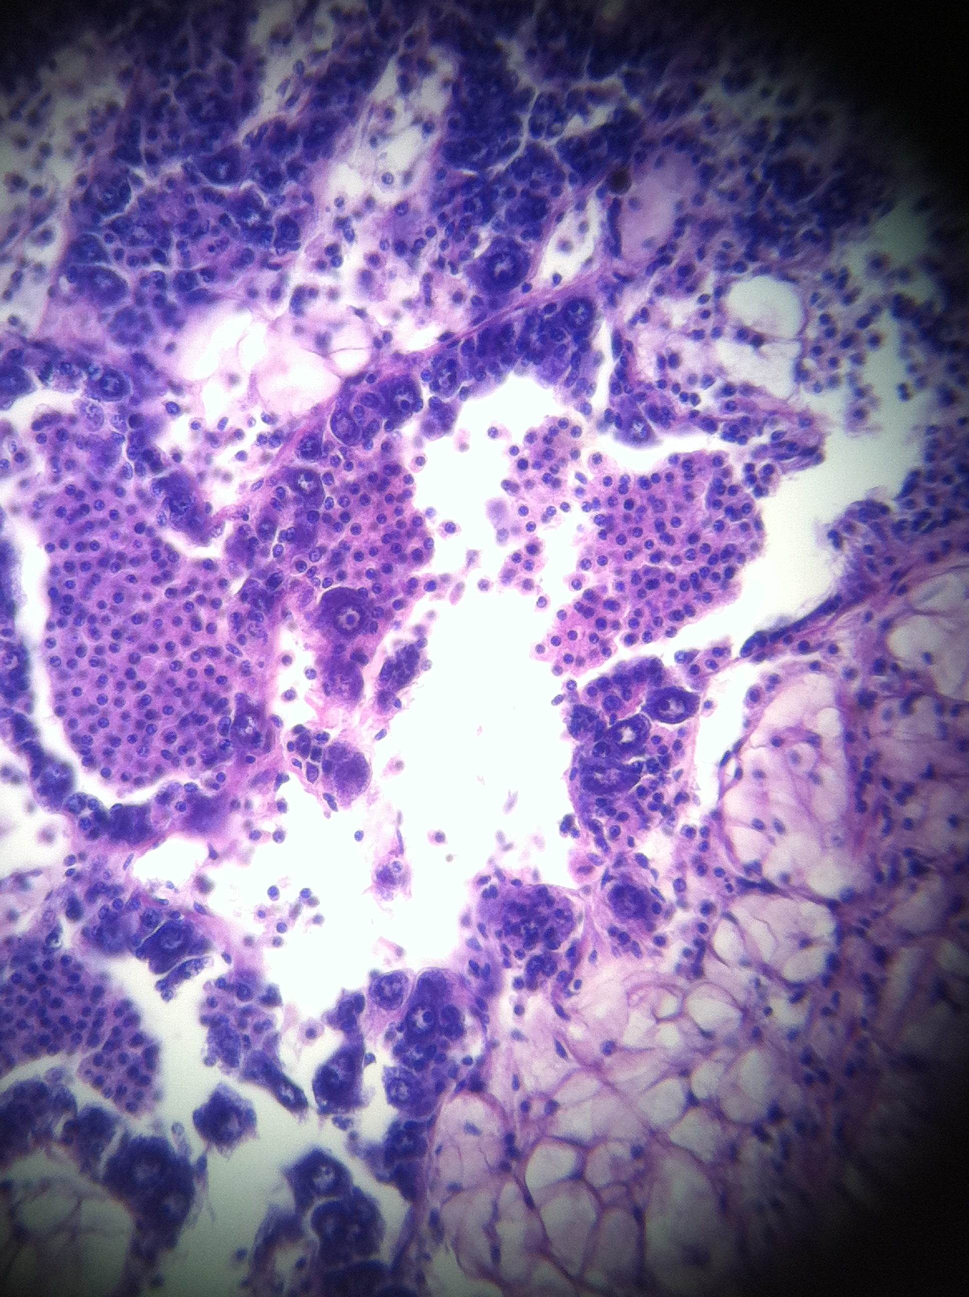
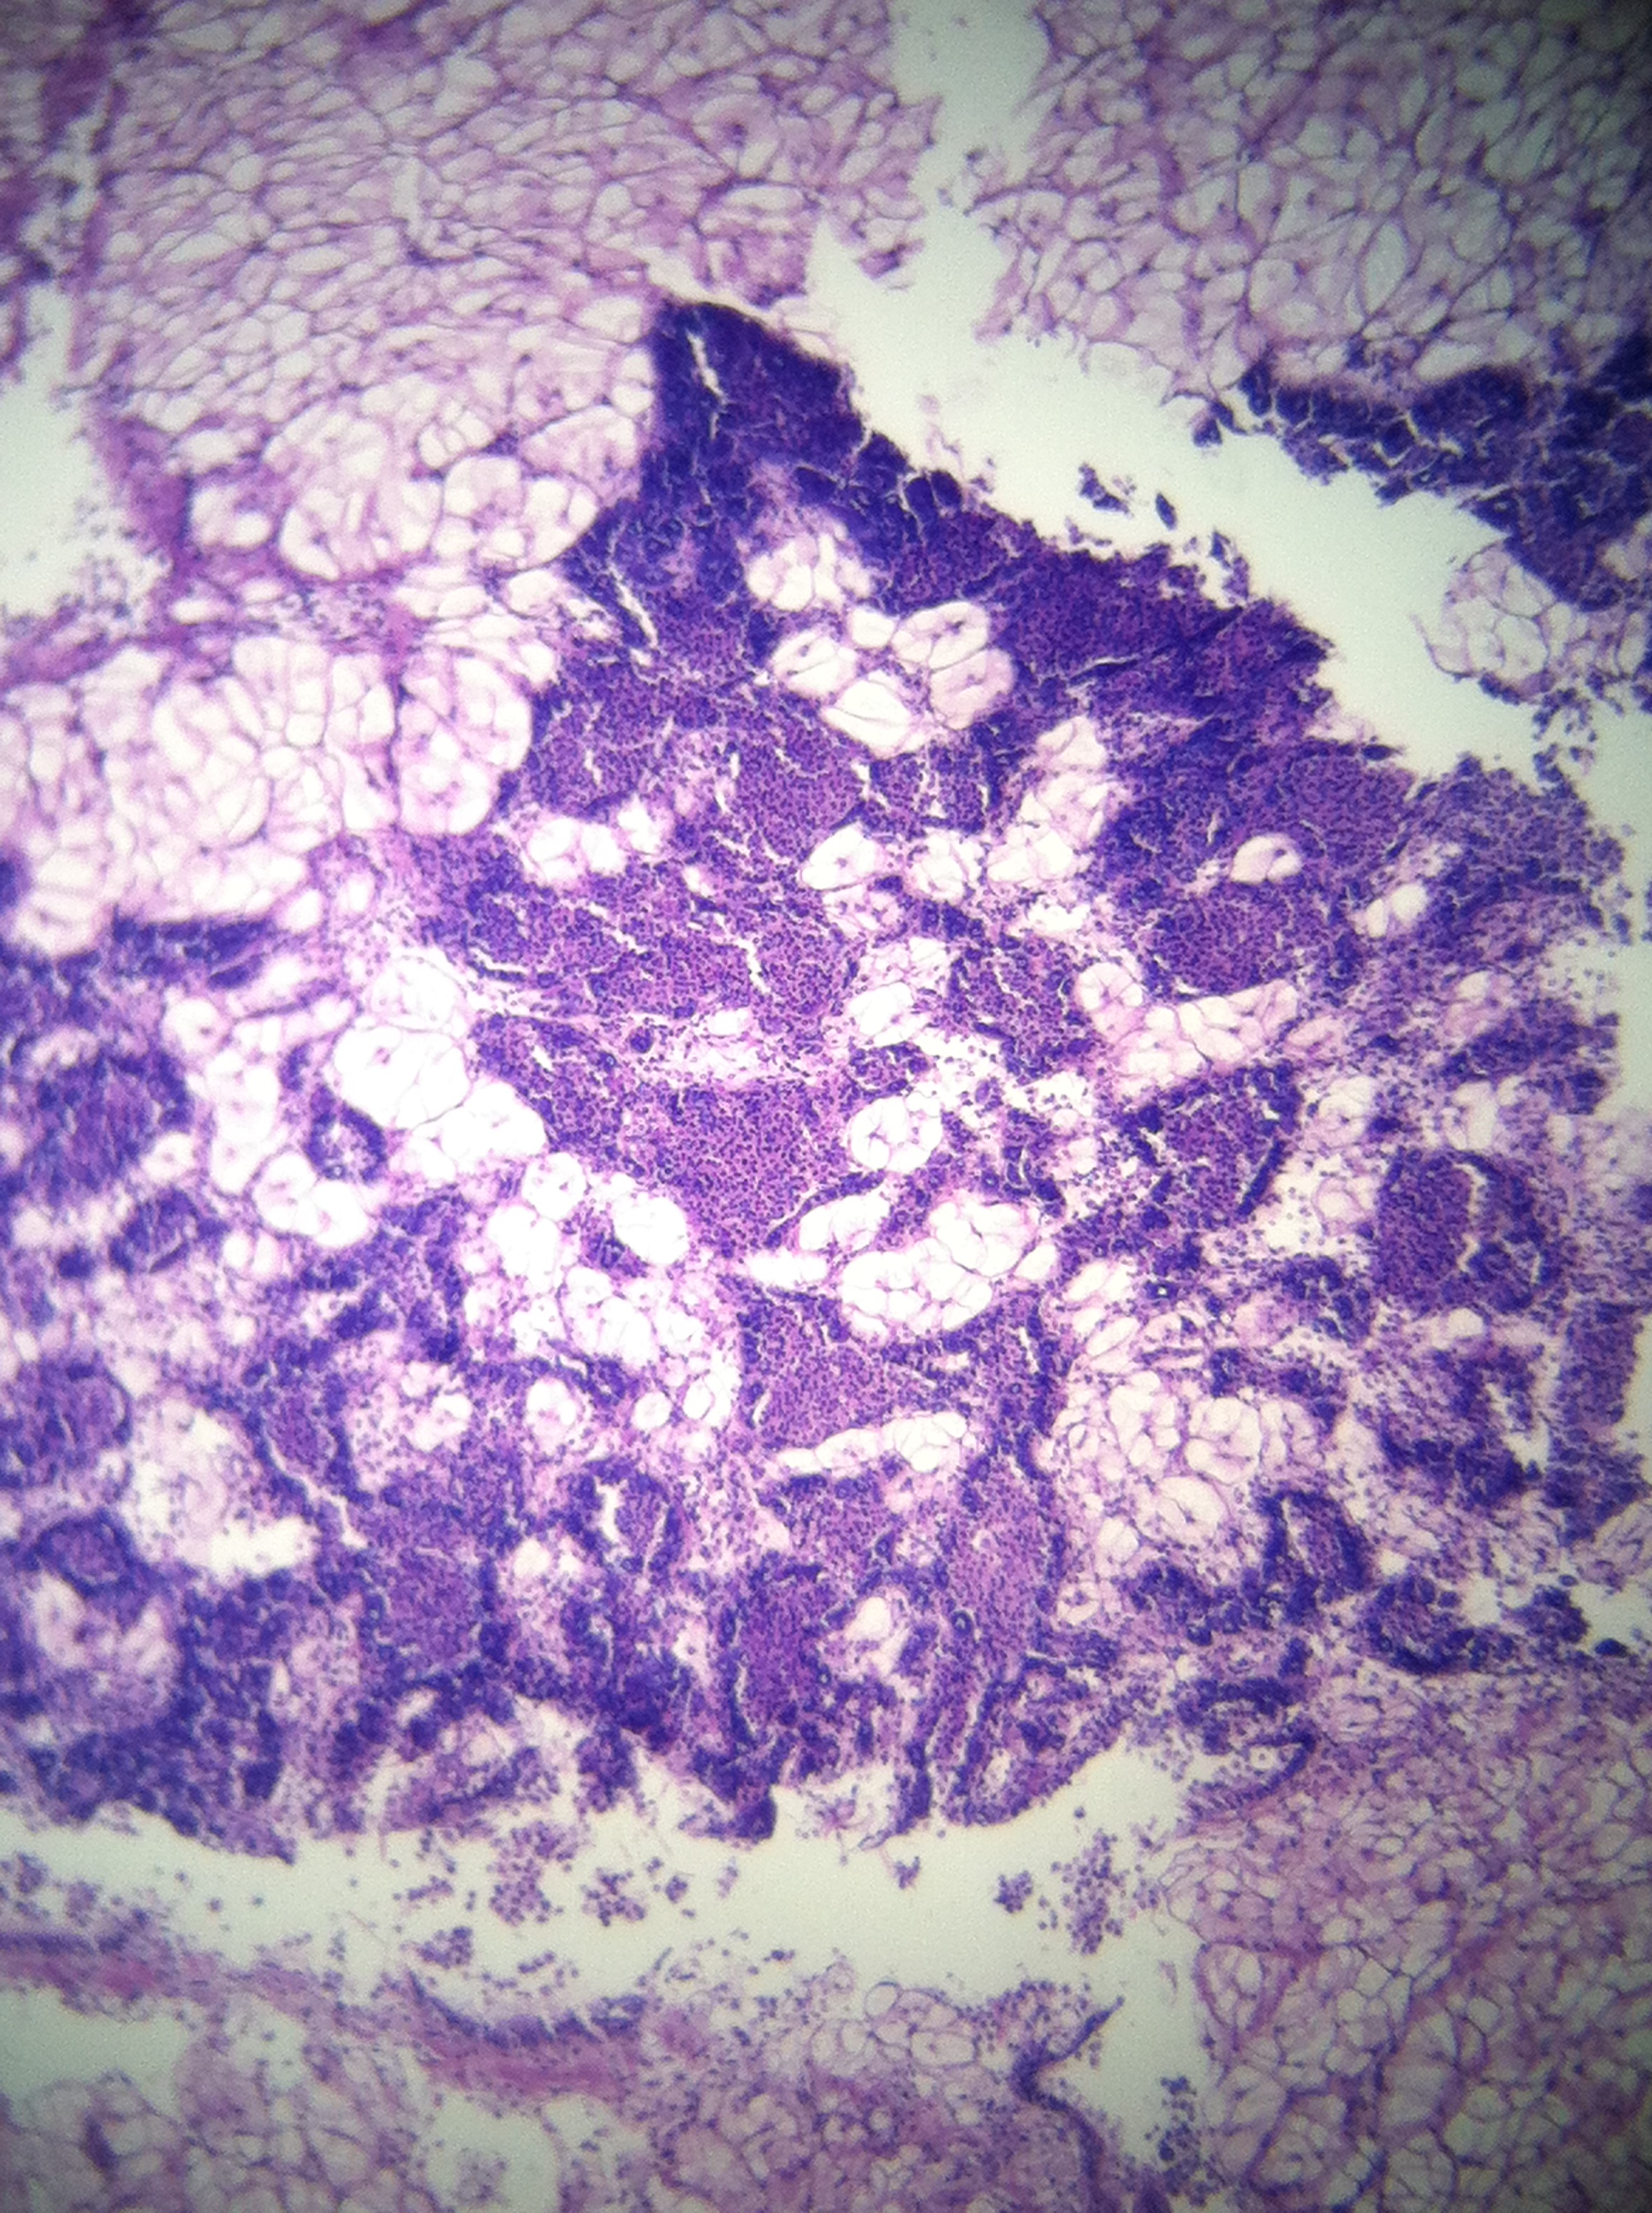
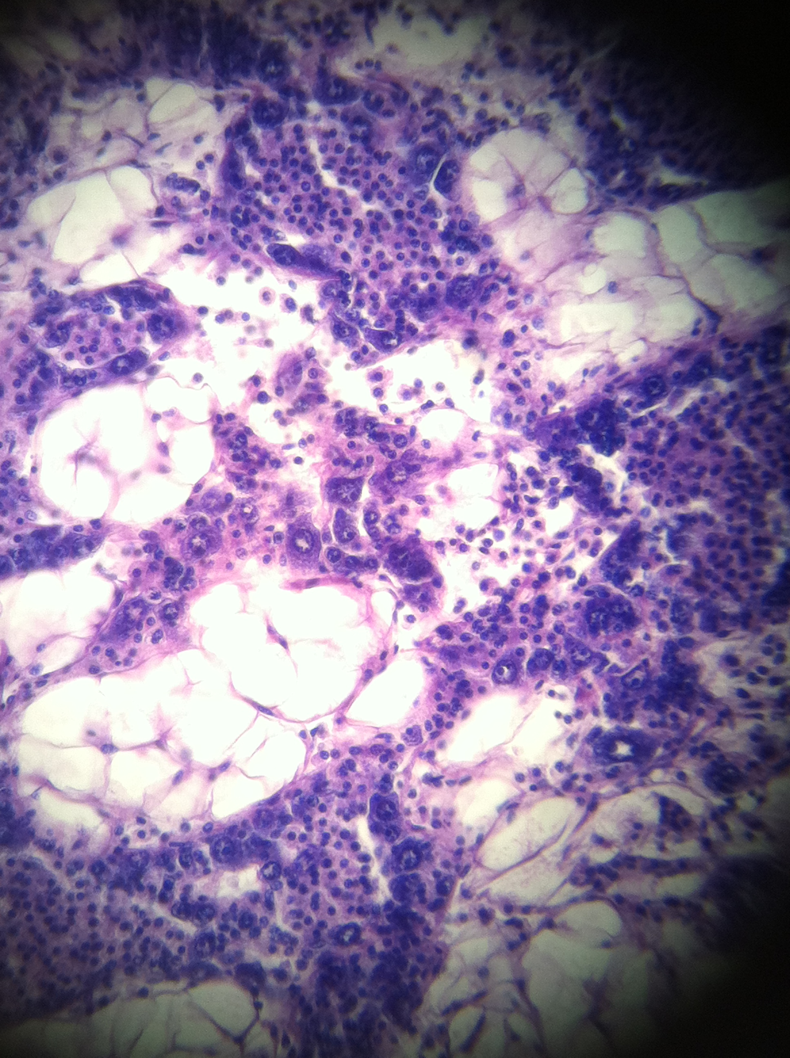
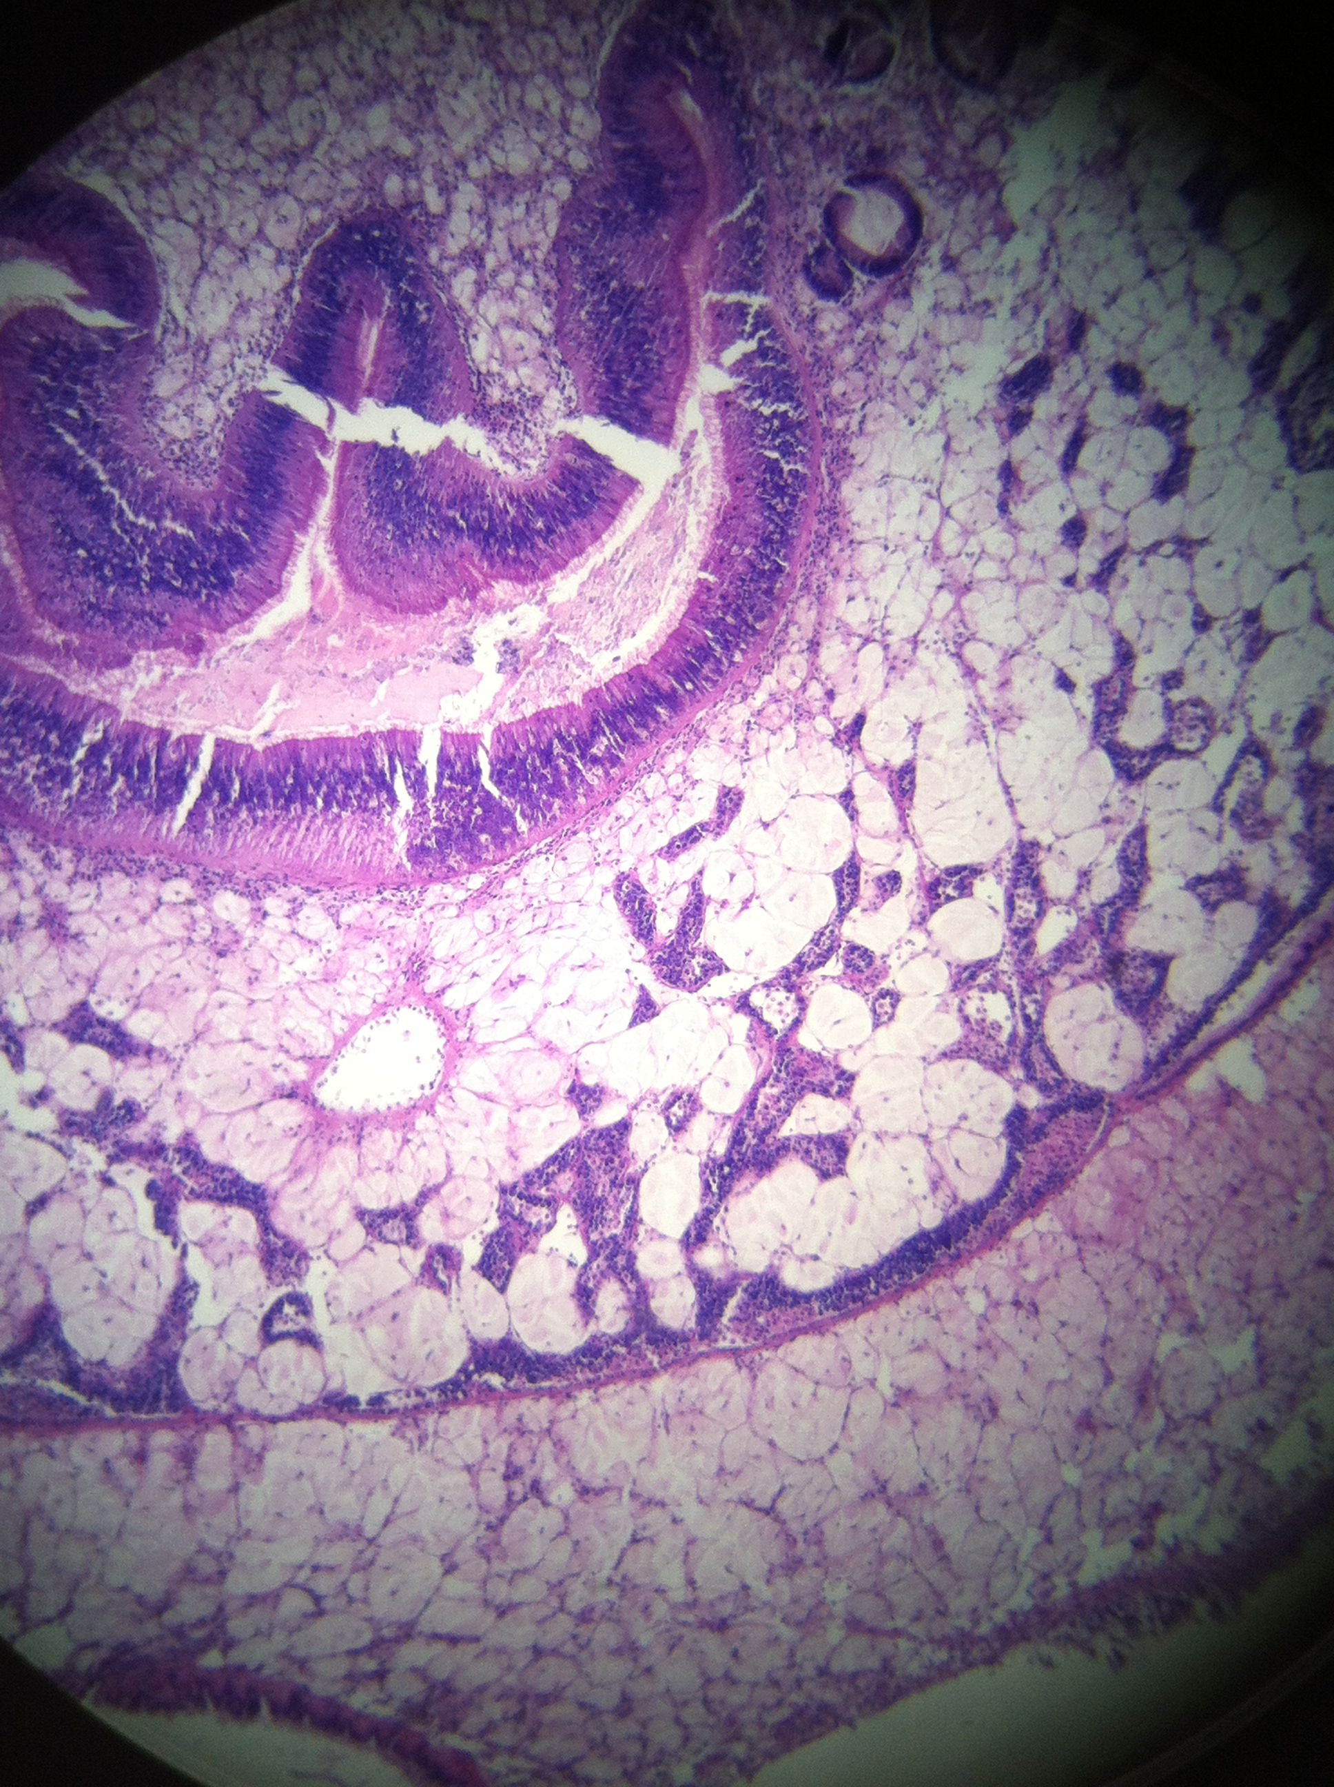
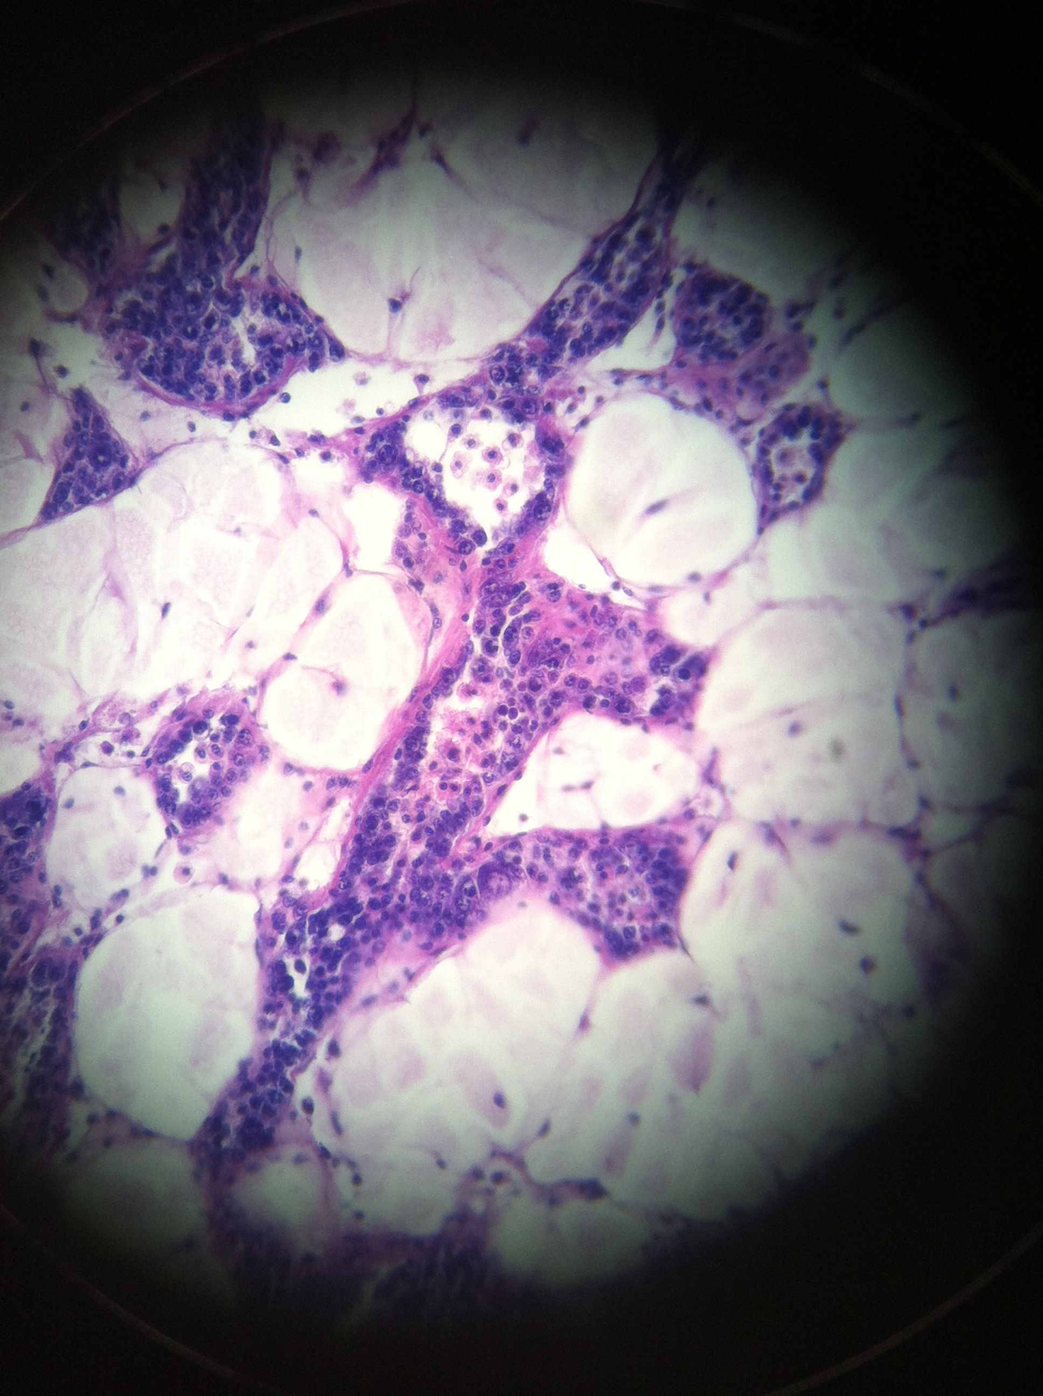
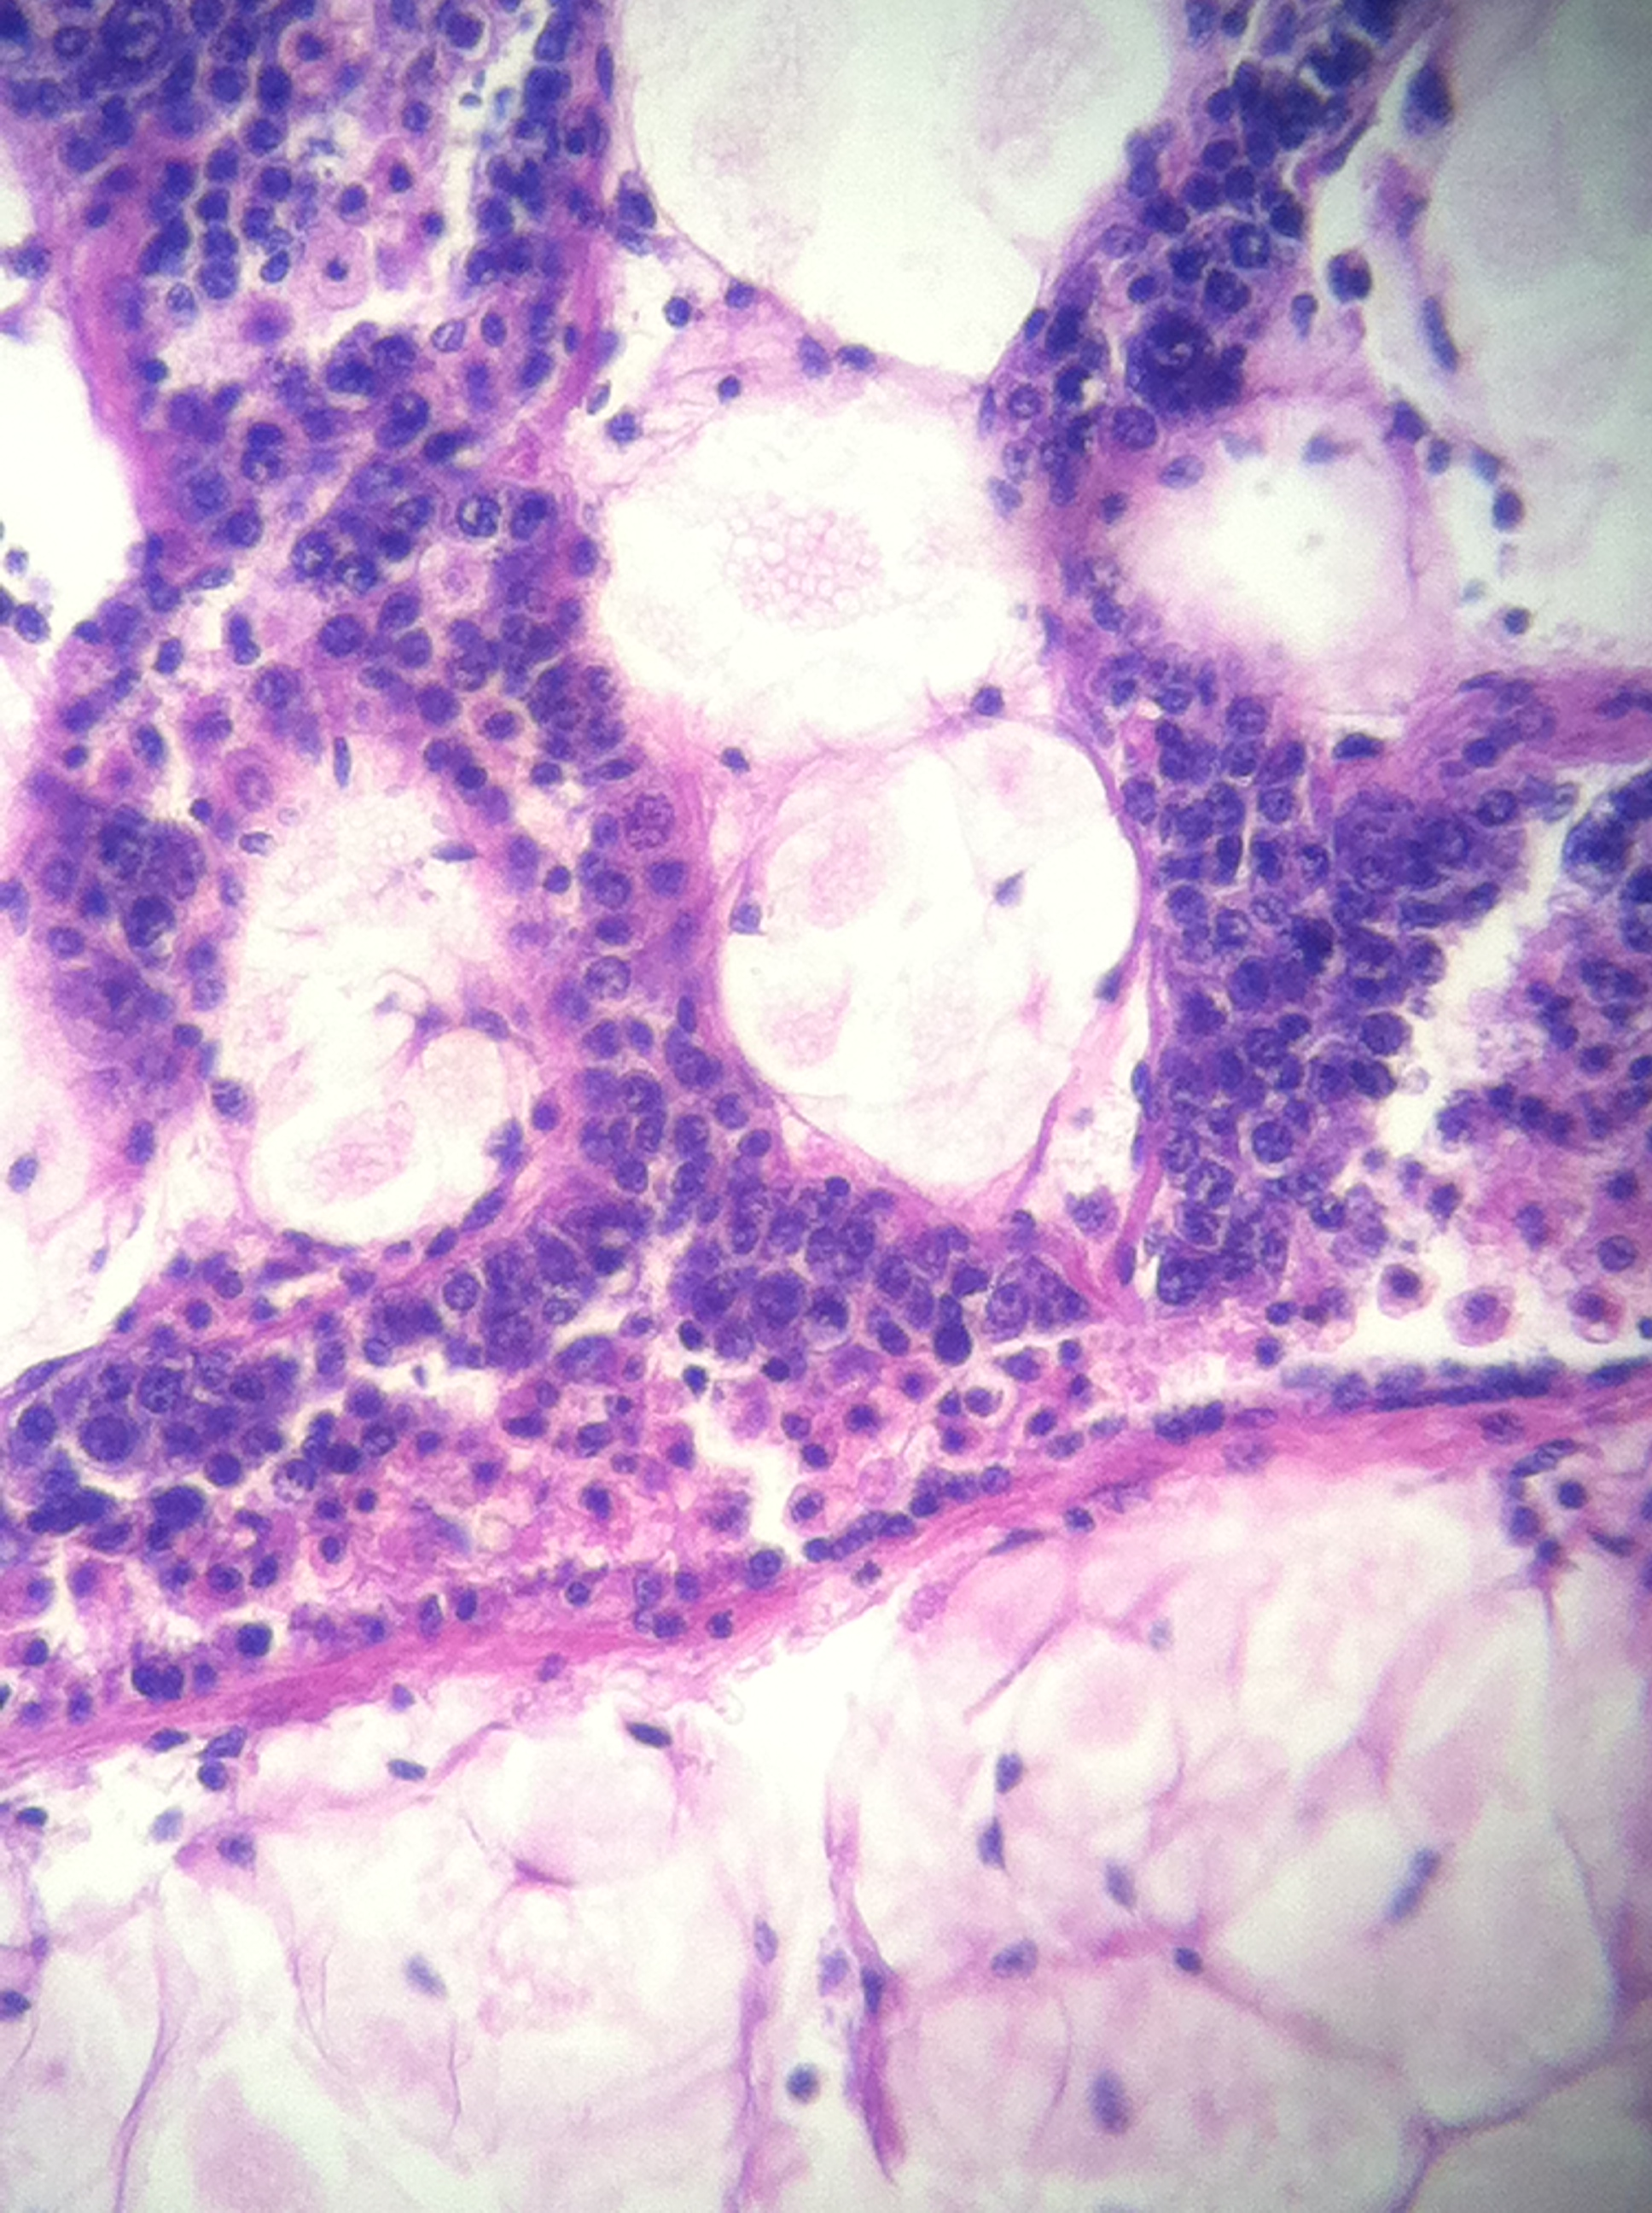
R819 - female
Stage 2 (late developing)
lots of hemocytes – inflammation
oocytes present about ½ free and the others attached
R554 - female
Stage 1 (early developing)
lots of connective tissue
follicles are small
oogonia on follicle walls, but no oocytes present

Slide 3
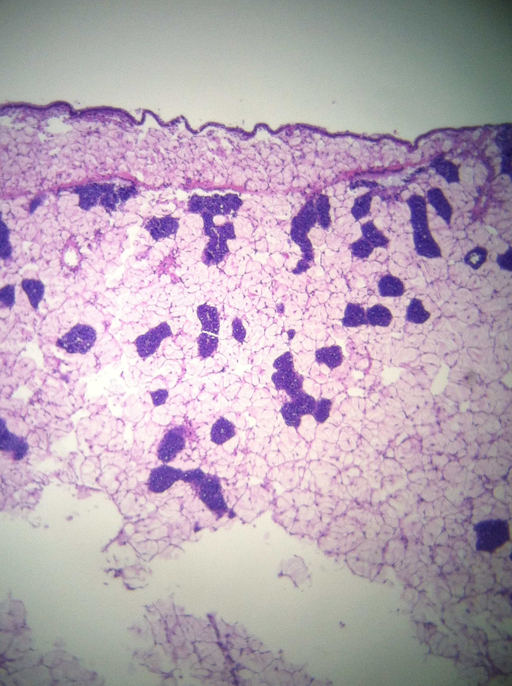
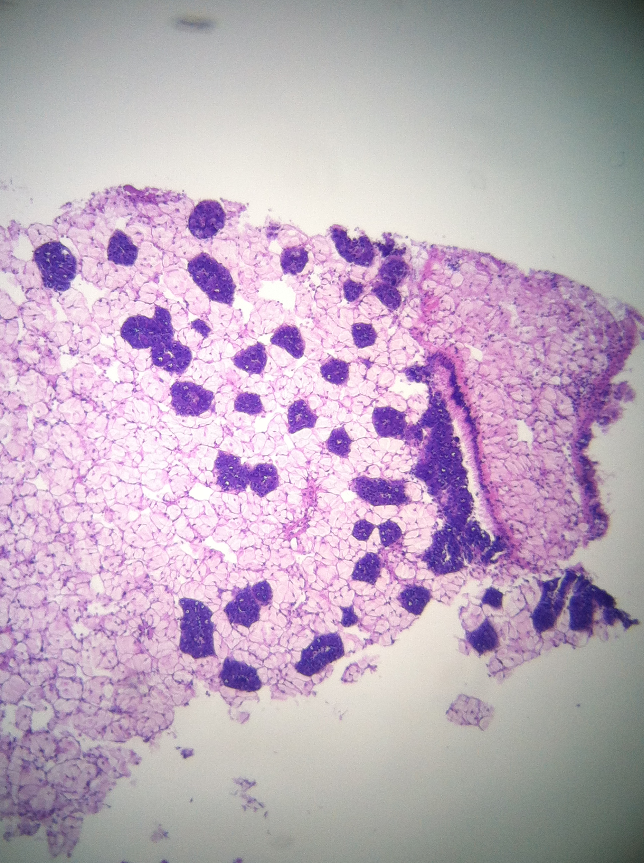
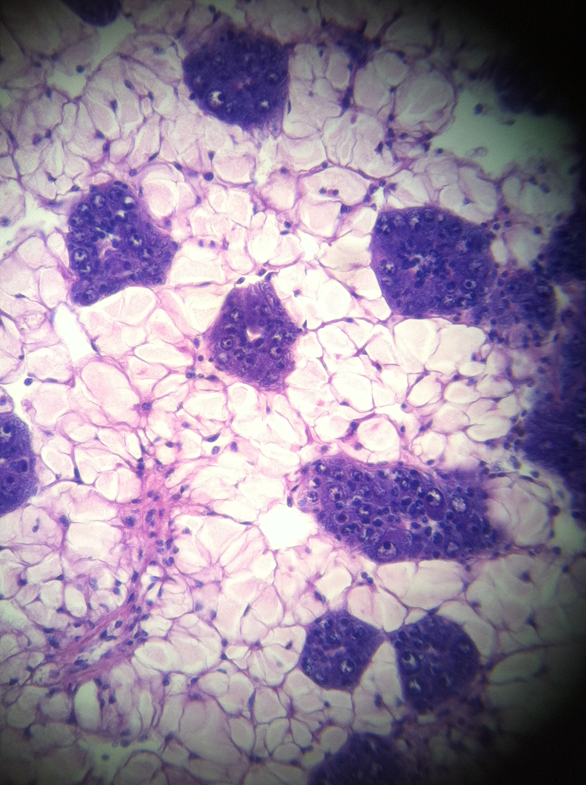
R818 - female
Stage 1 (early developing)
Lots of connective tissue, small follicles
oogonia present on follicle wall, no oocytes present

Slide 4
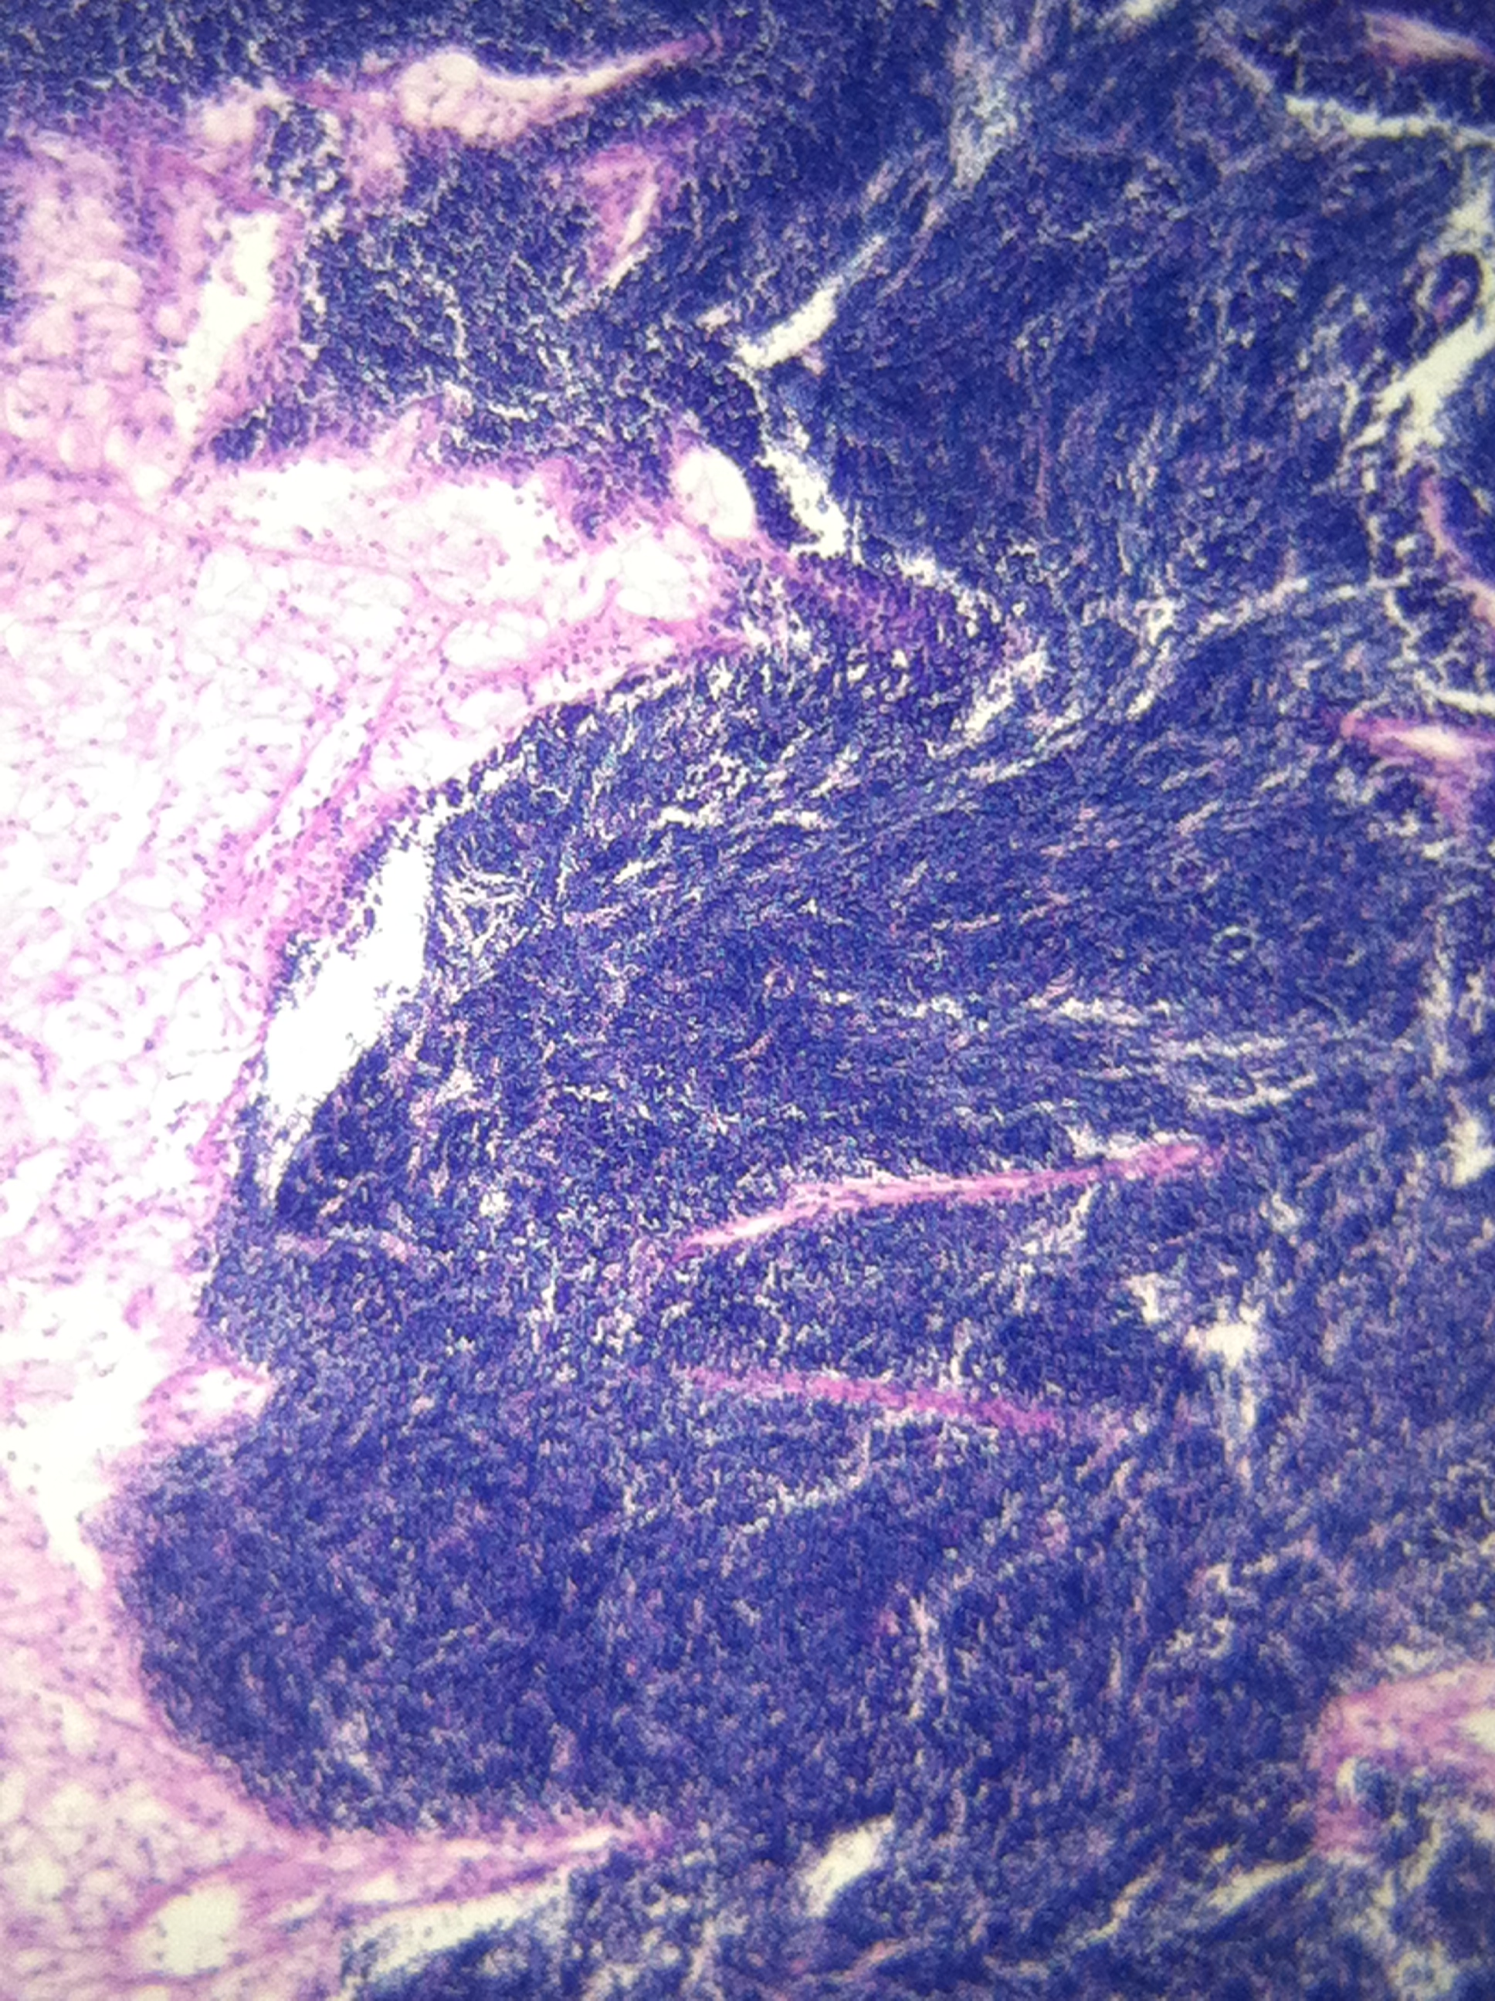
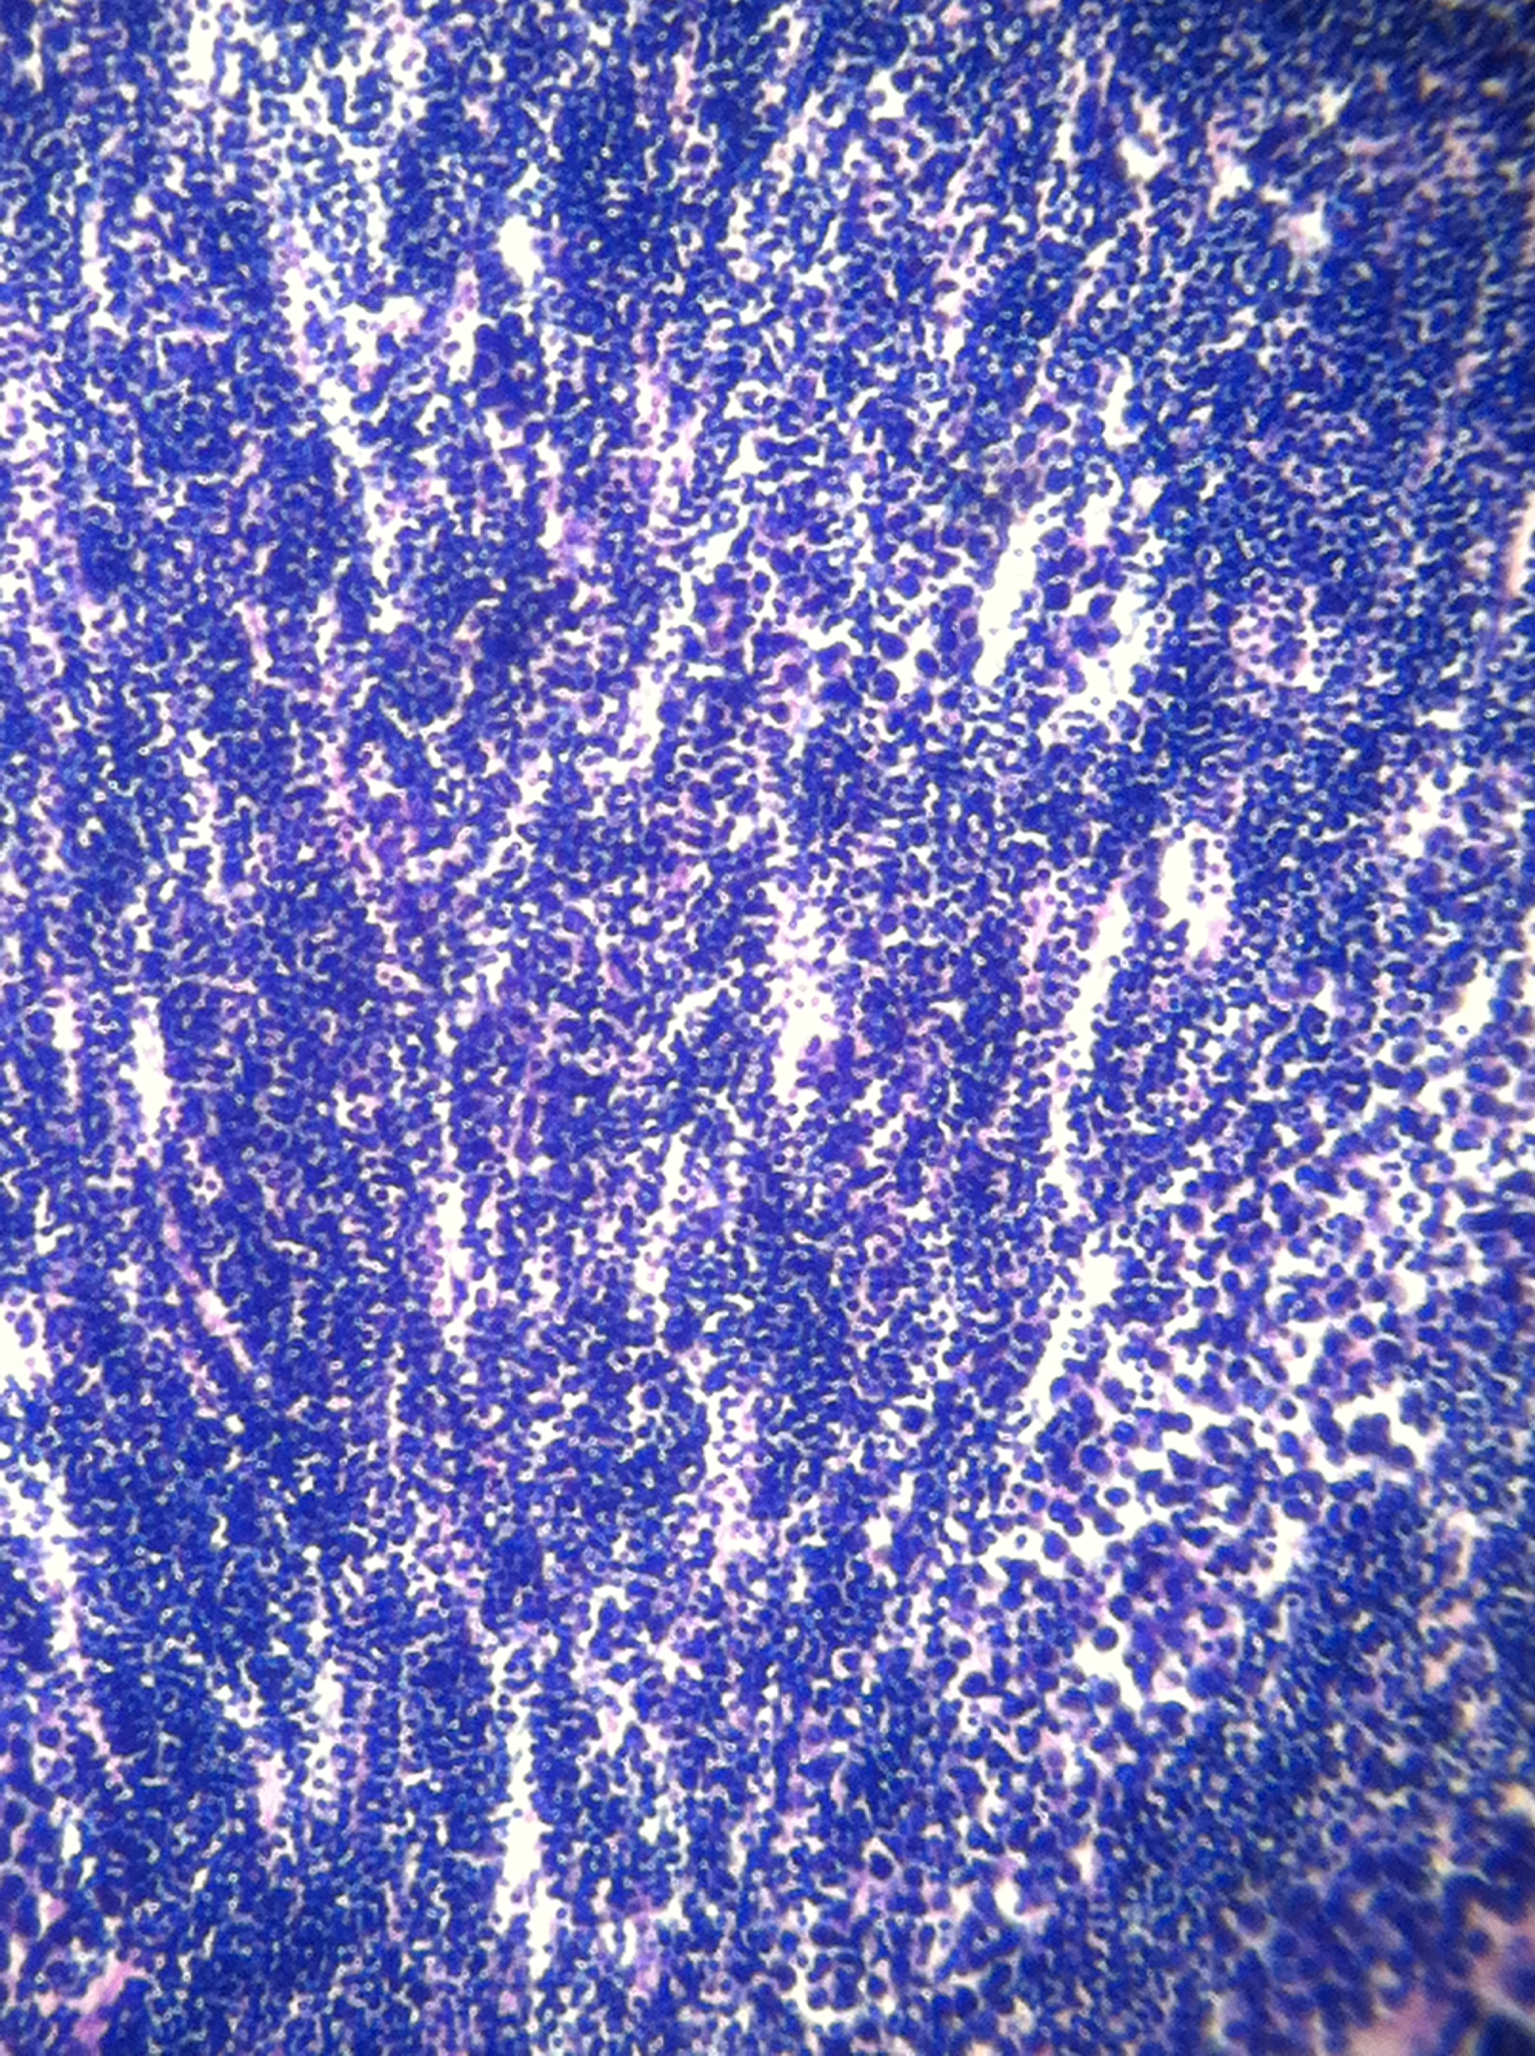
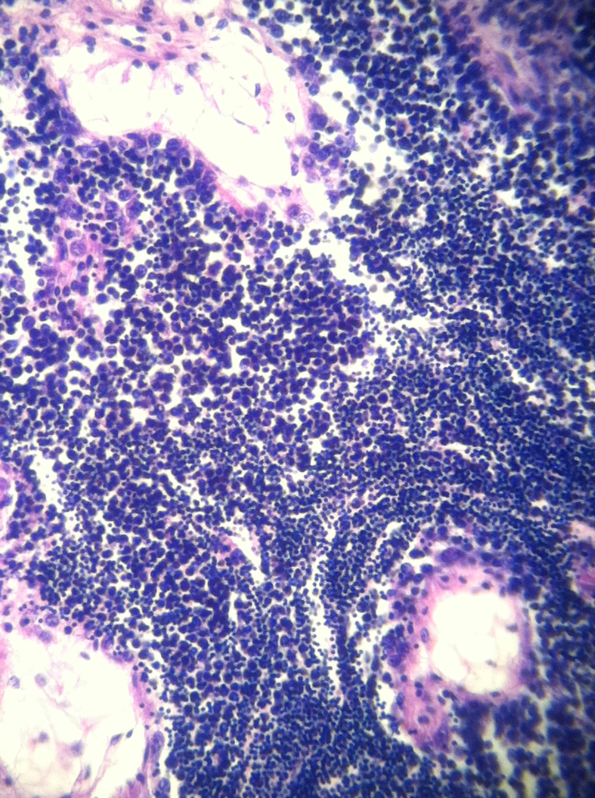
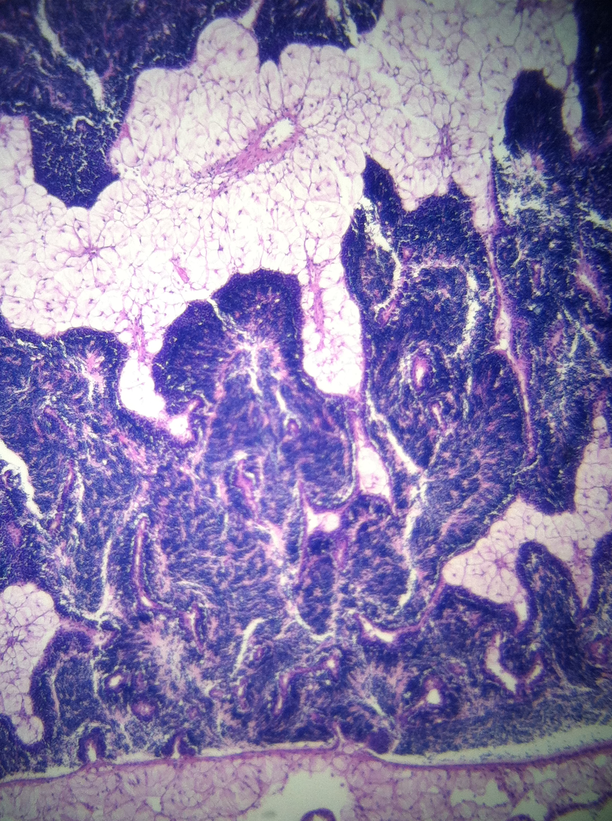
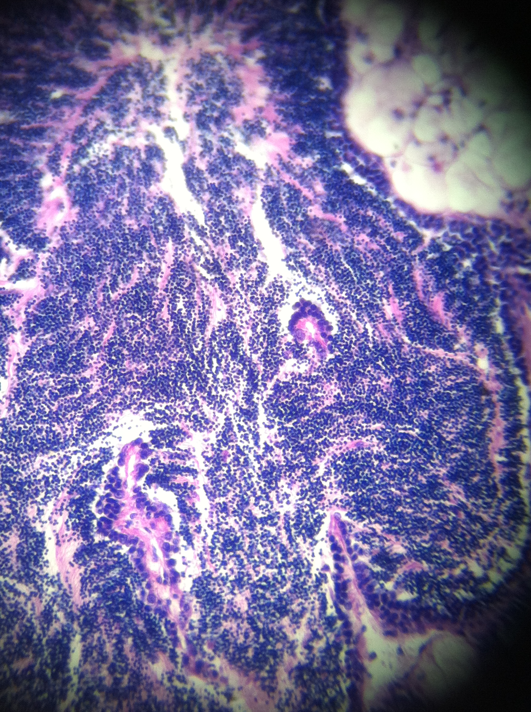
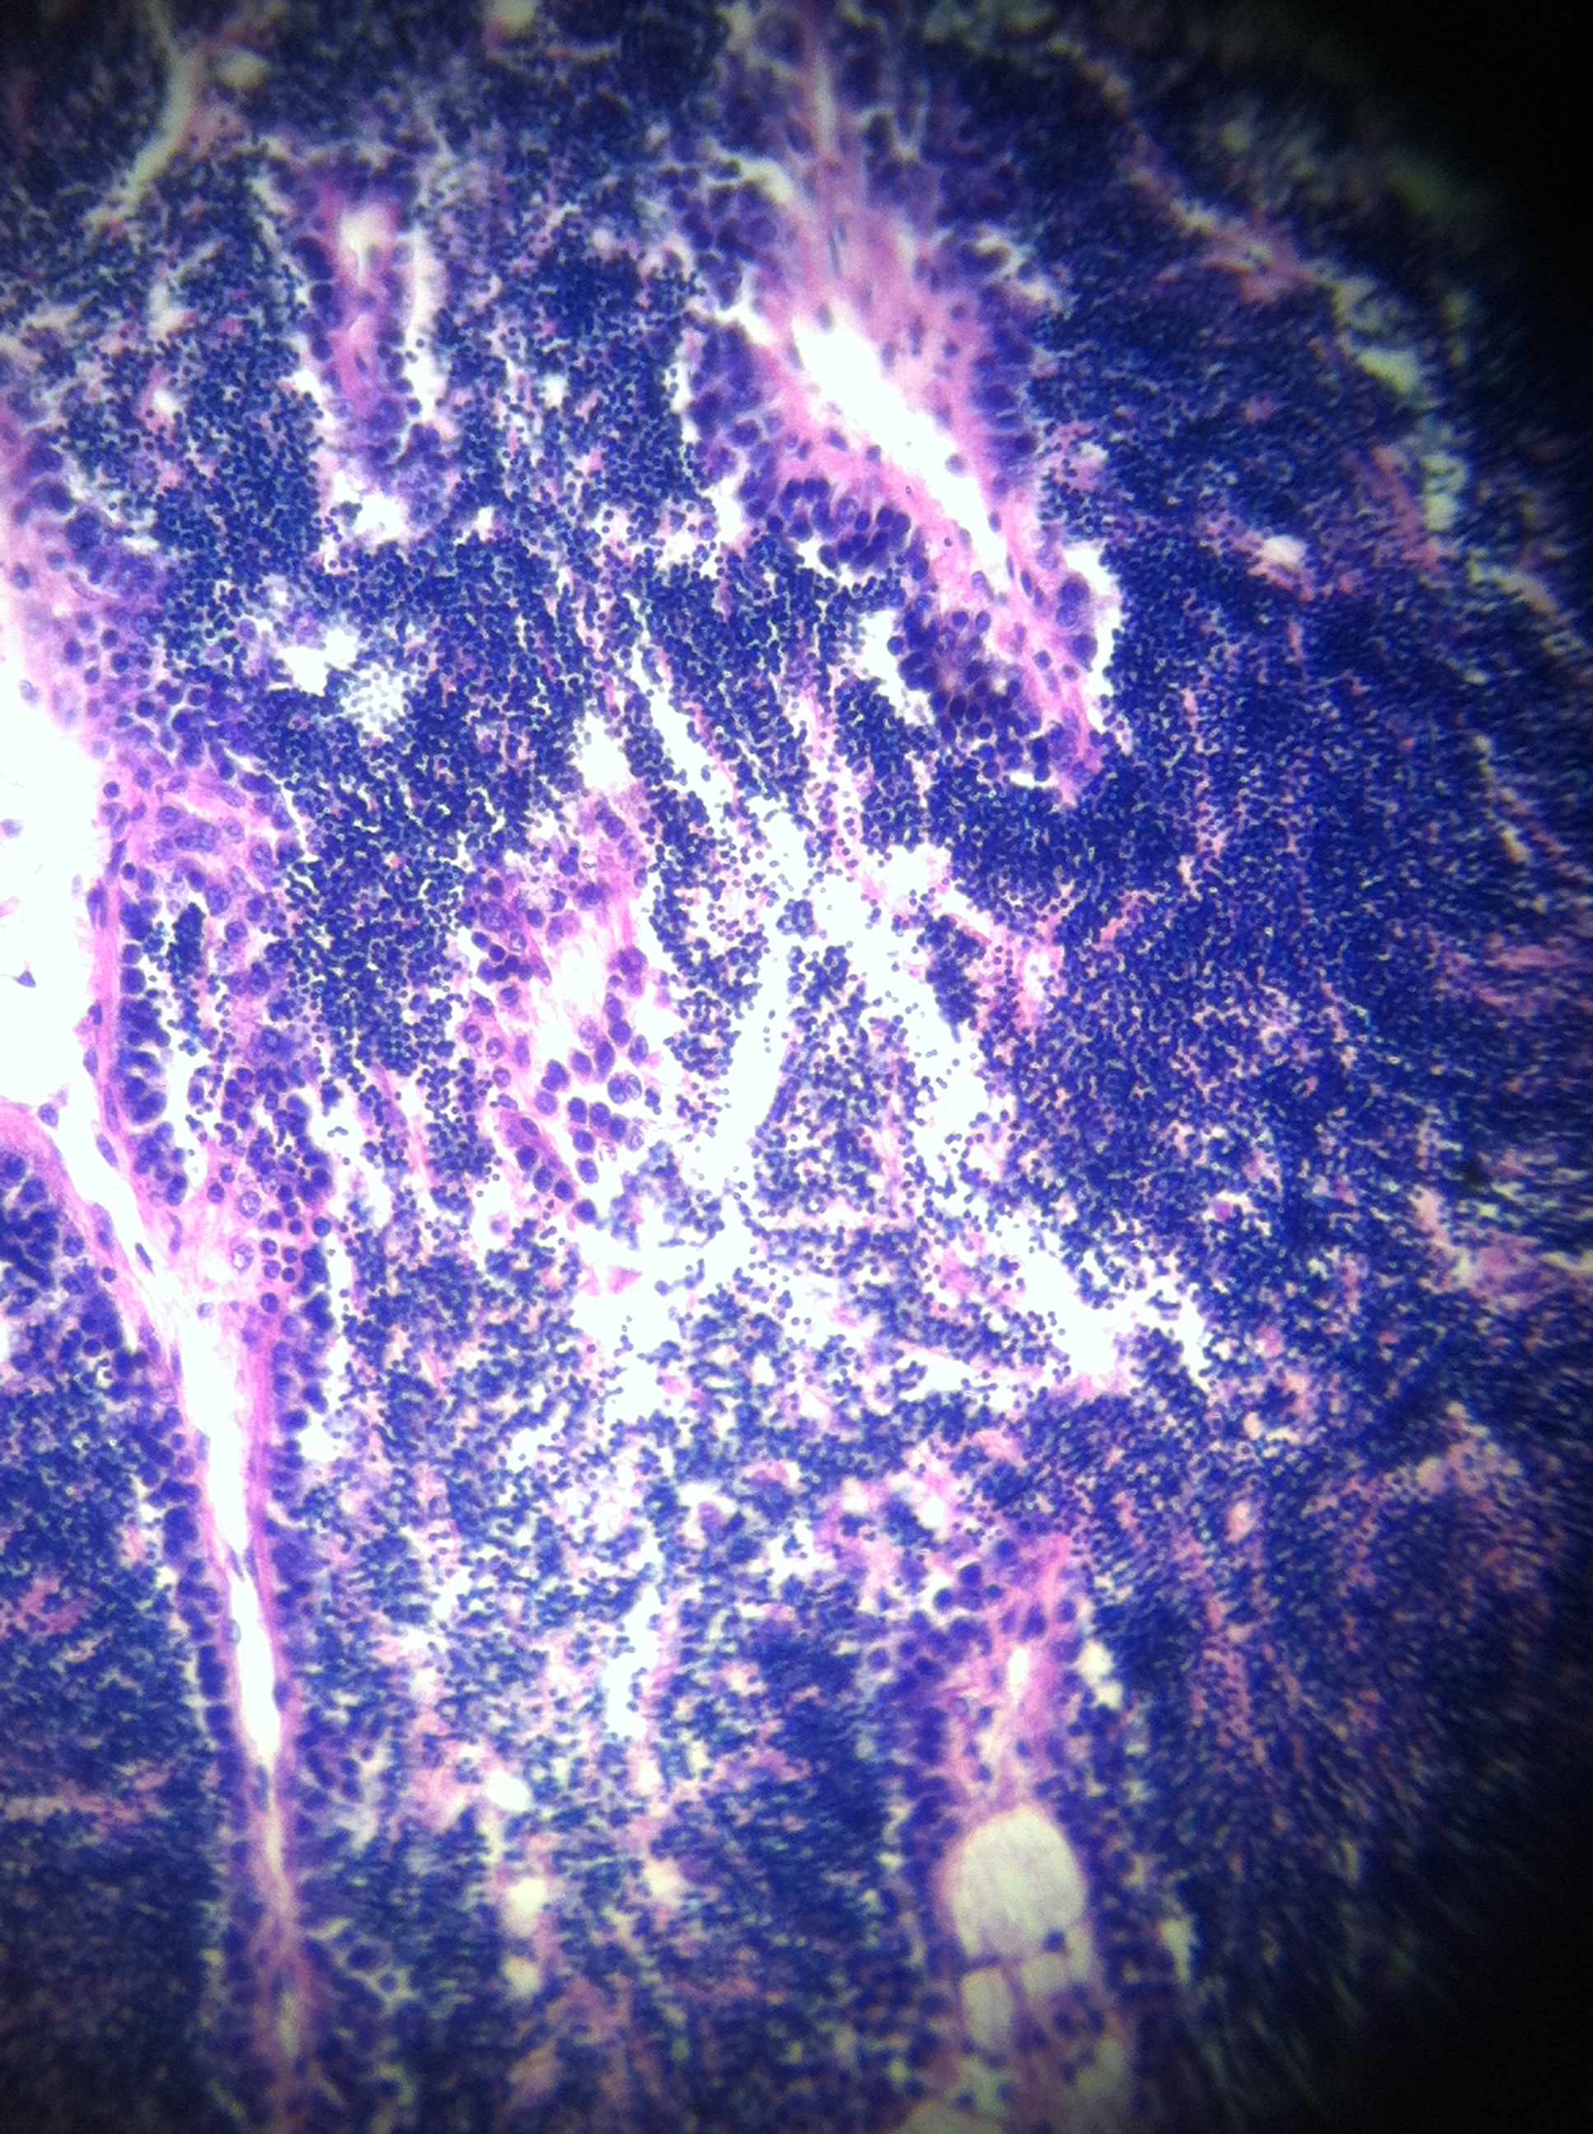
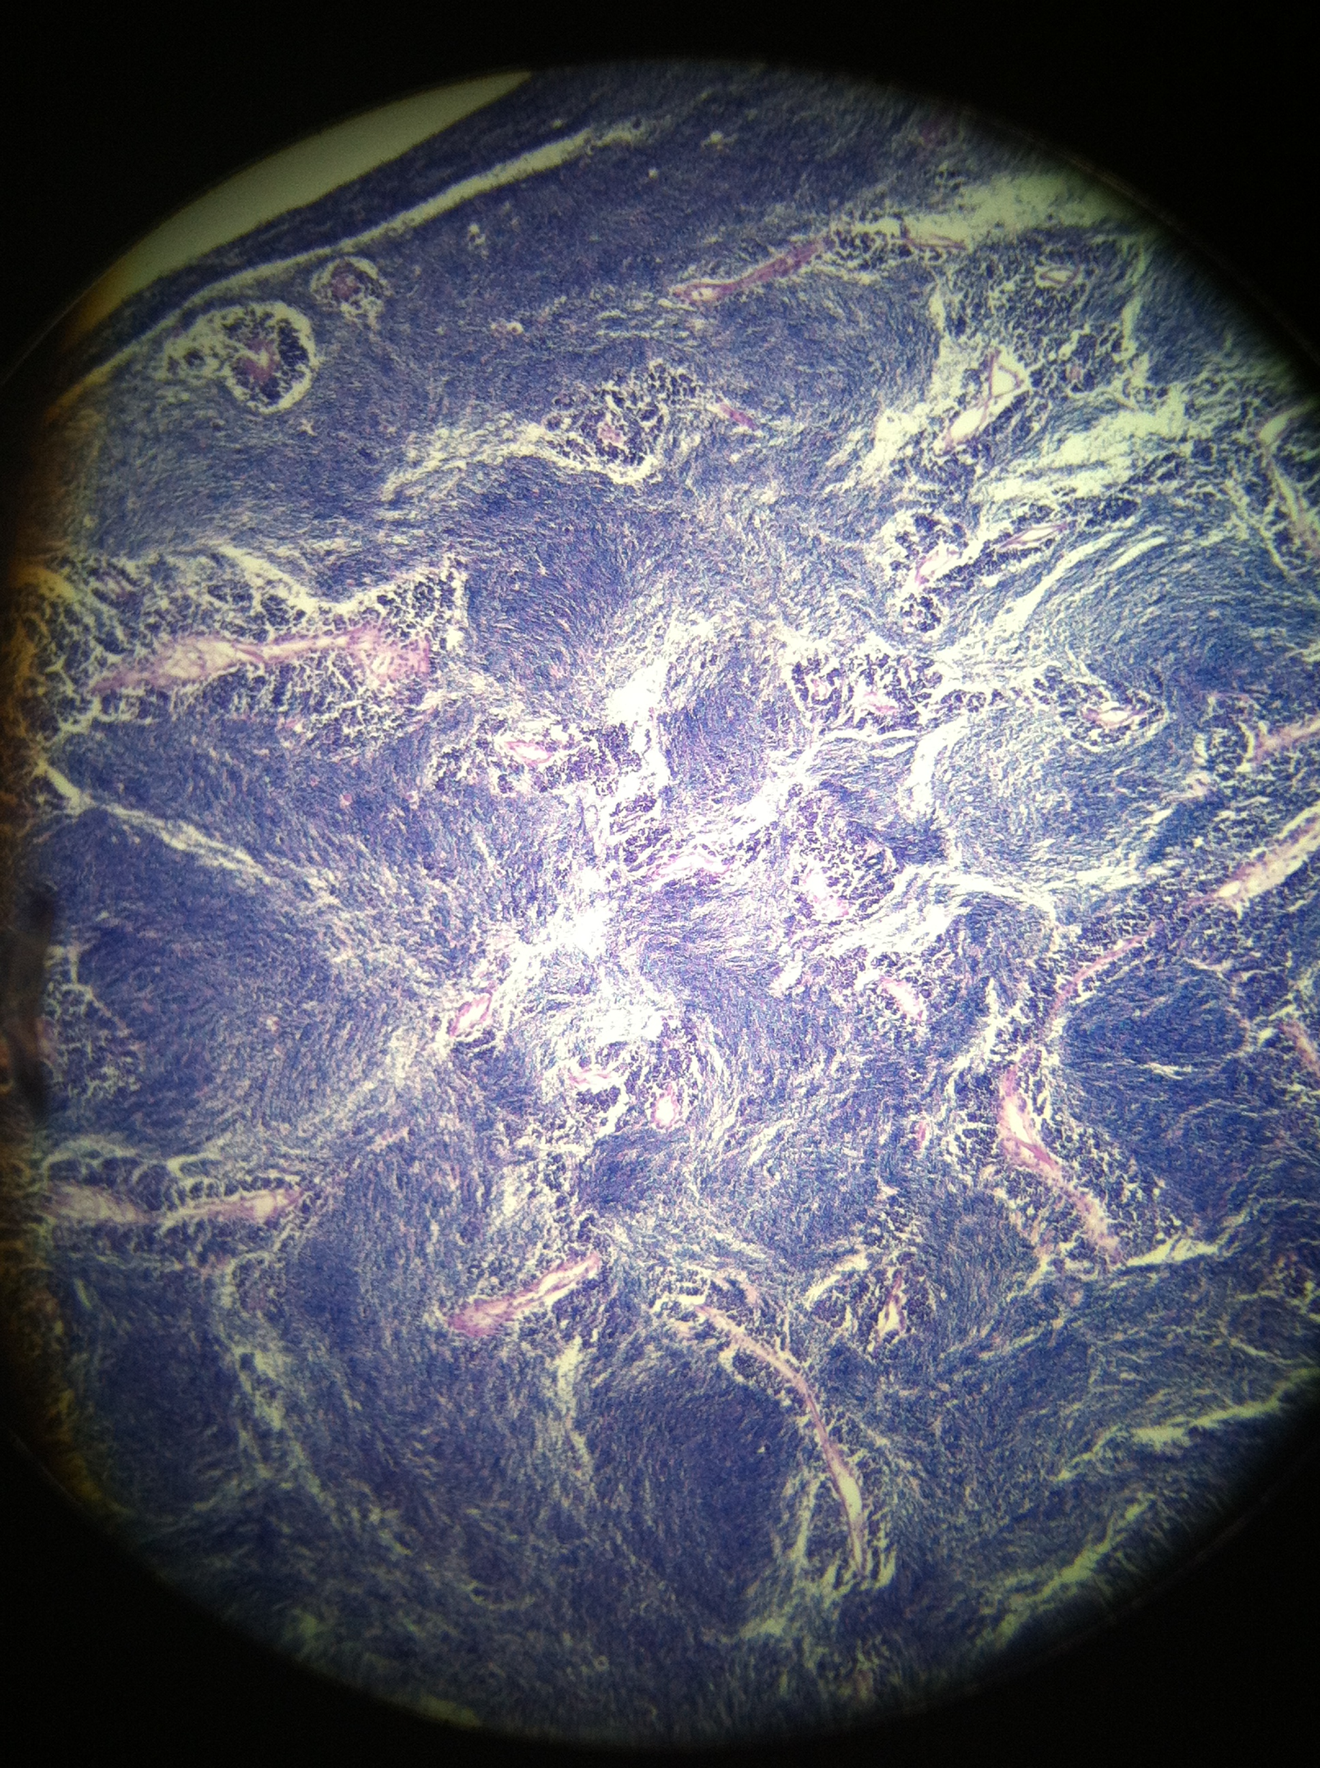
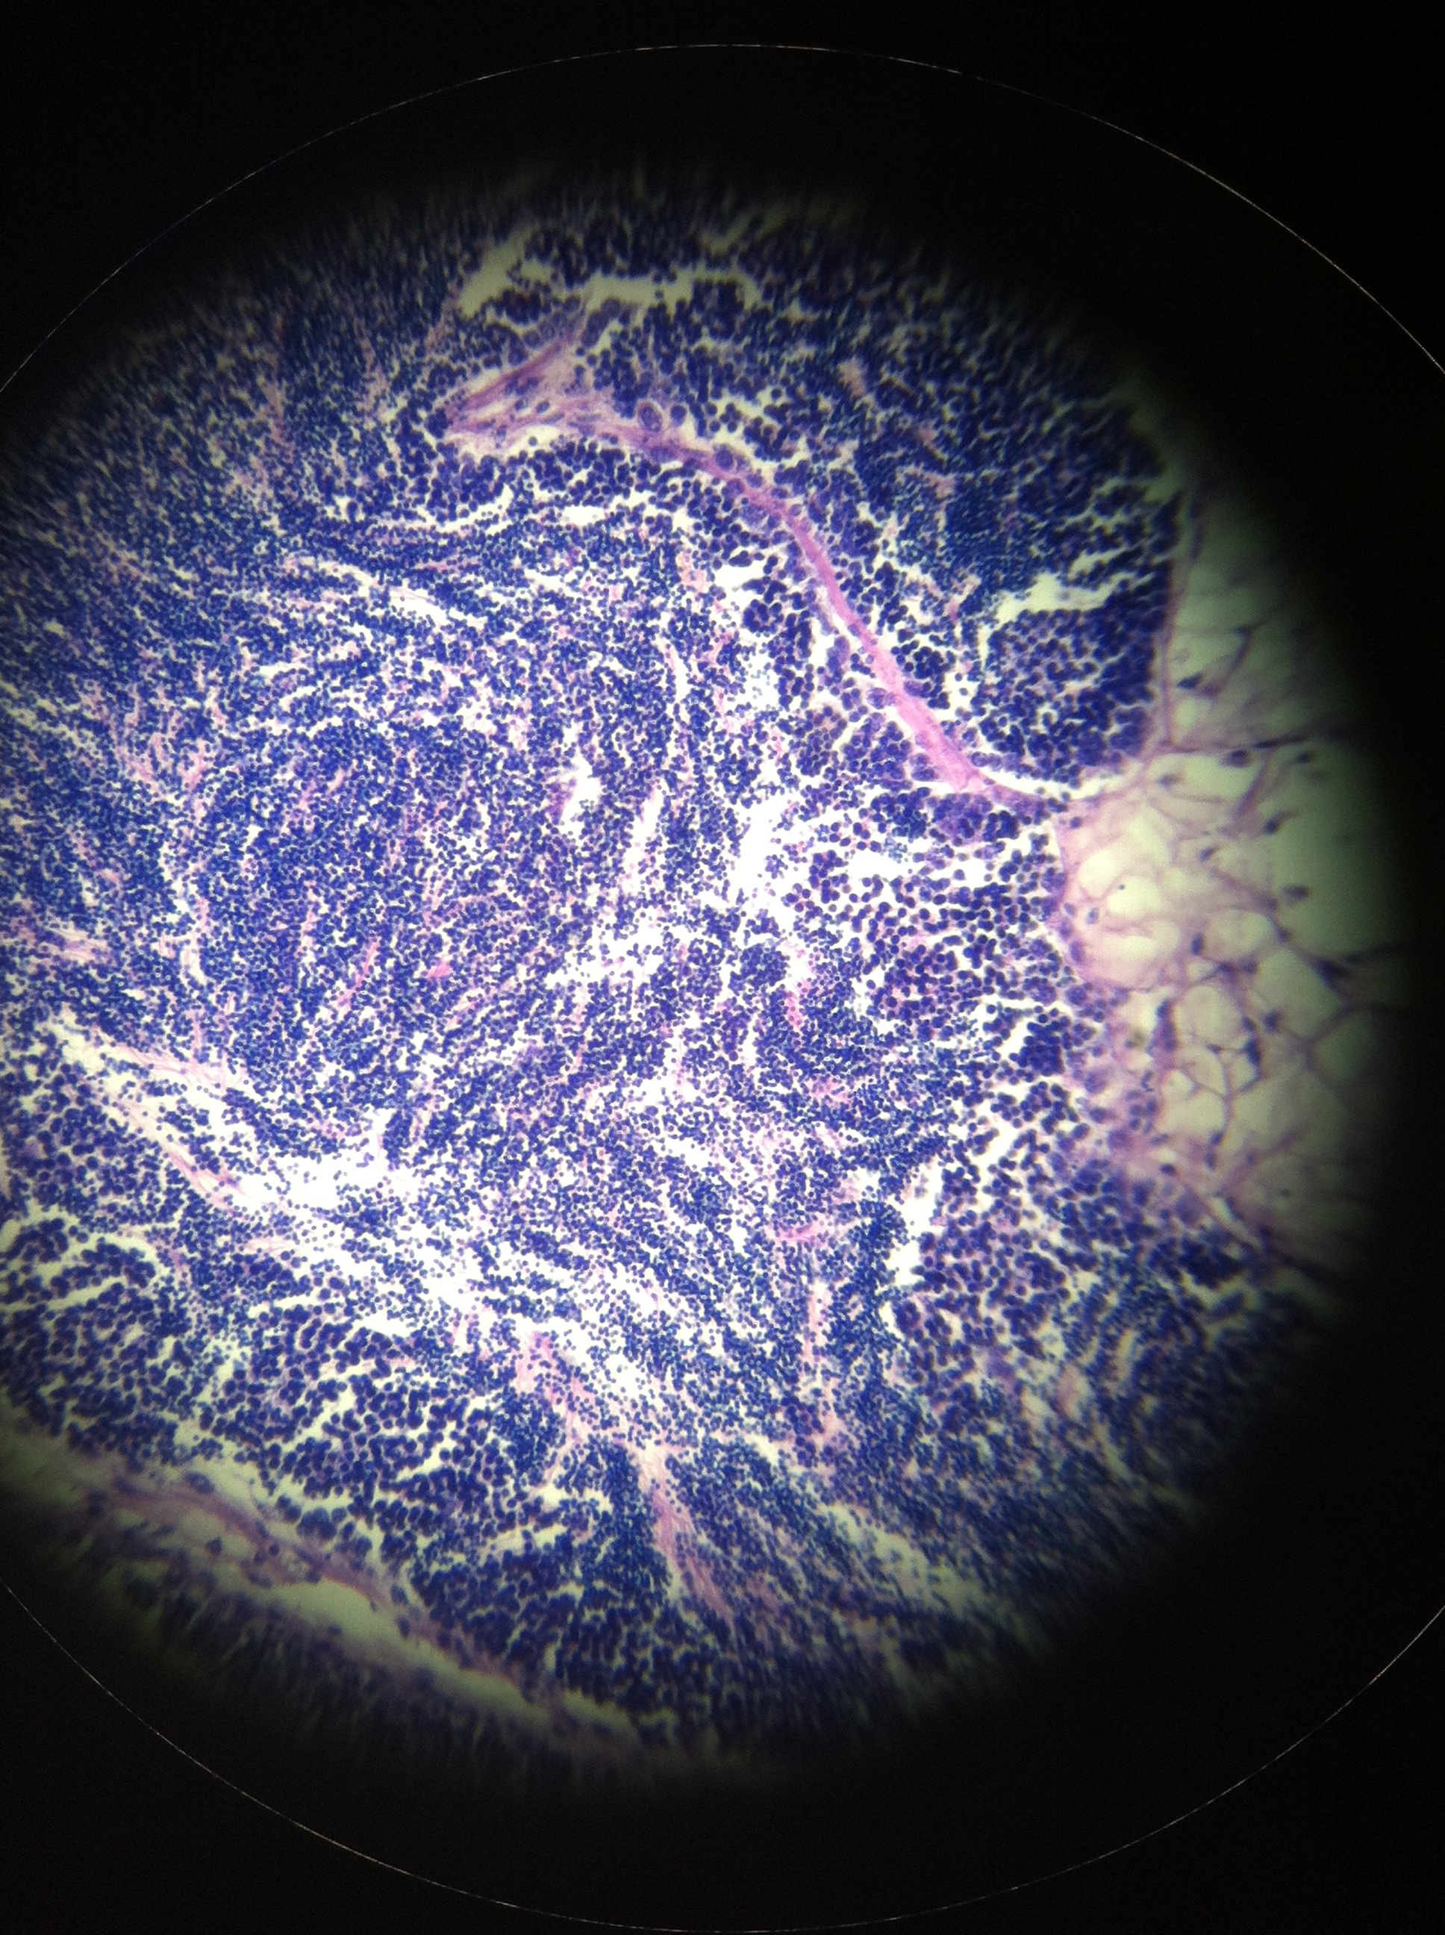
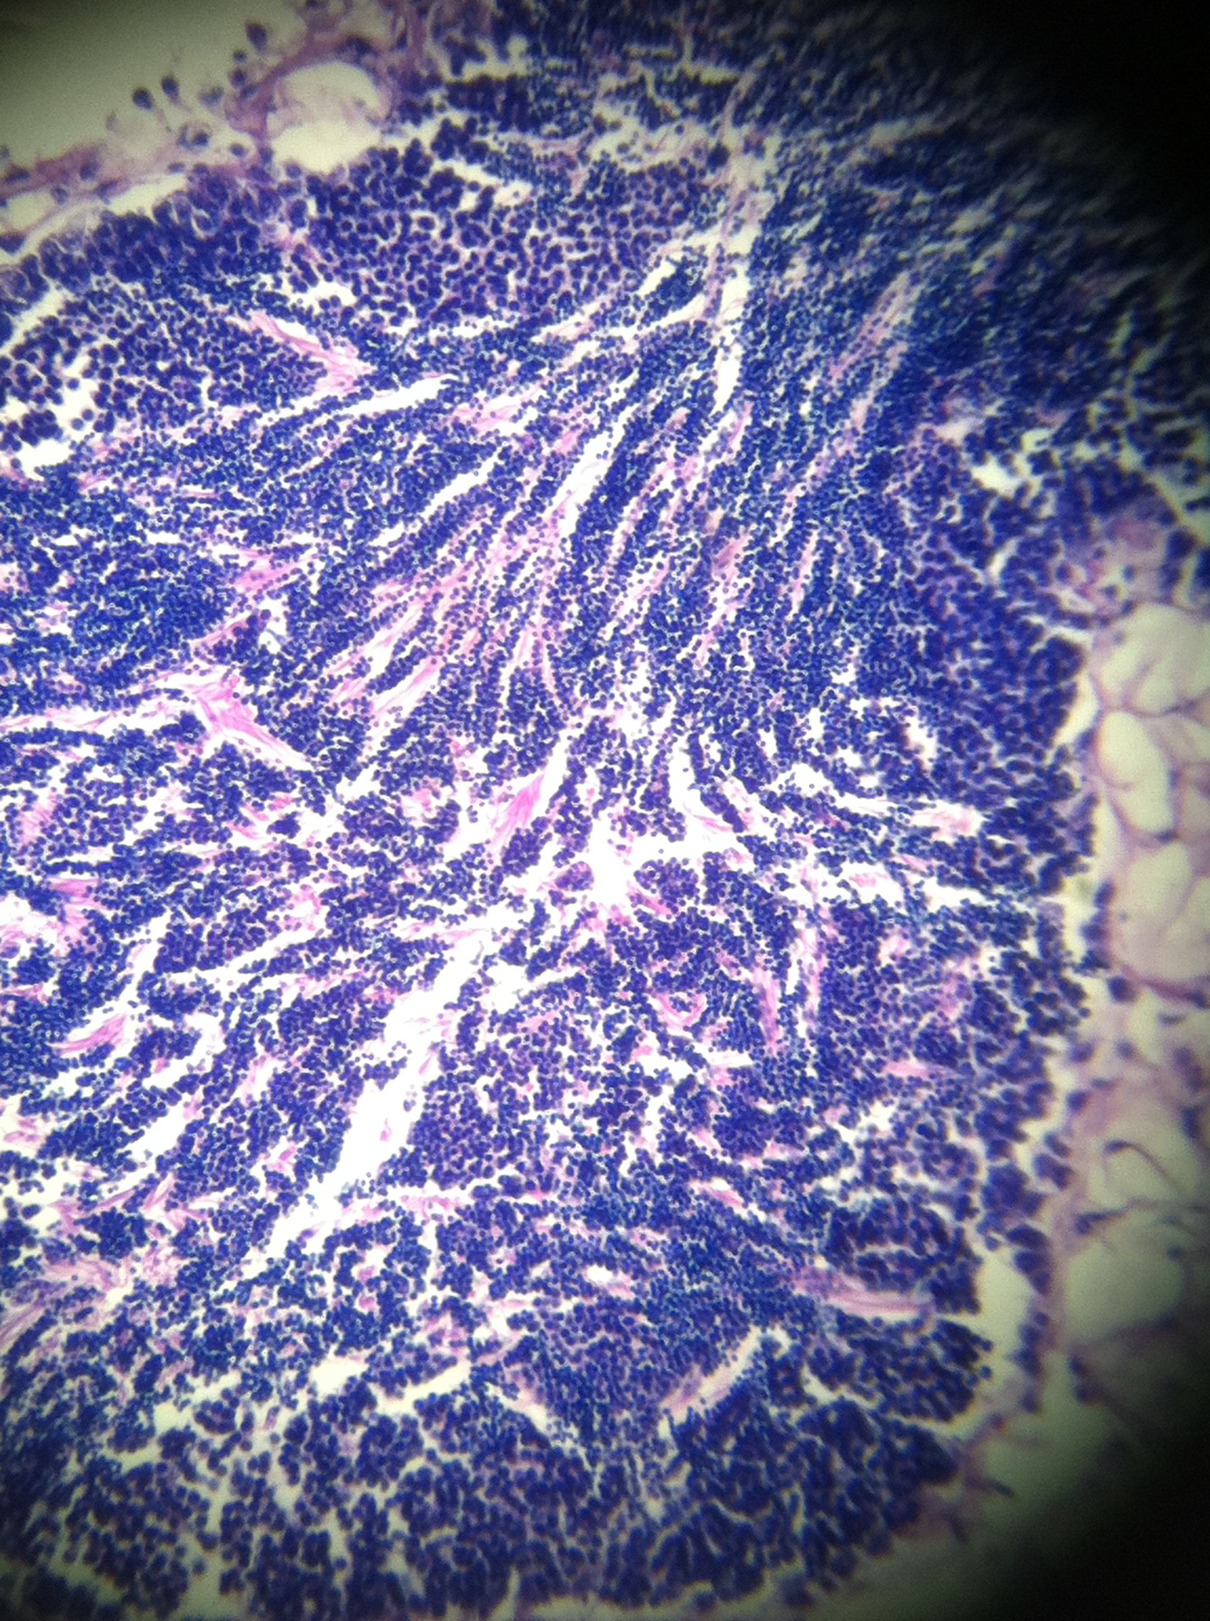
R874 - male
Stage 3 (ripe)
follicles filled w/ spermatazoa, tails to follicle lumen
characteristic swirling pattern
inconspicuous inter follicular tissue and germinal epithelium
R373 - male
Stage 2 (late developing)
follicles primarily spermatids and spermatozoa
tails toward lumen of follicle
characteristic swirling of spermatazoa
R363 - male
Stage 3 (ripe)
follicles filled w/ spermatazoa, talks to follicle lumen
characteristic swirling pattern
inconspicuous inter follicular tissue and germinal epithelium

Slide 5
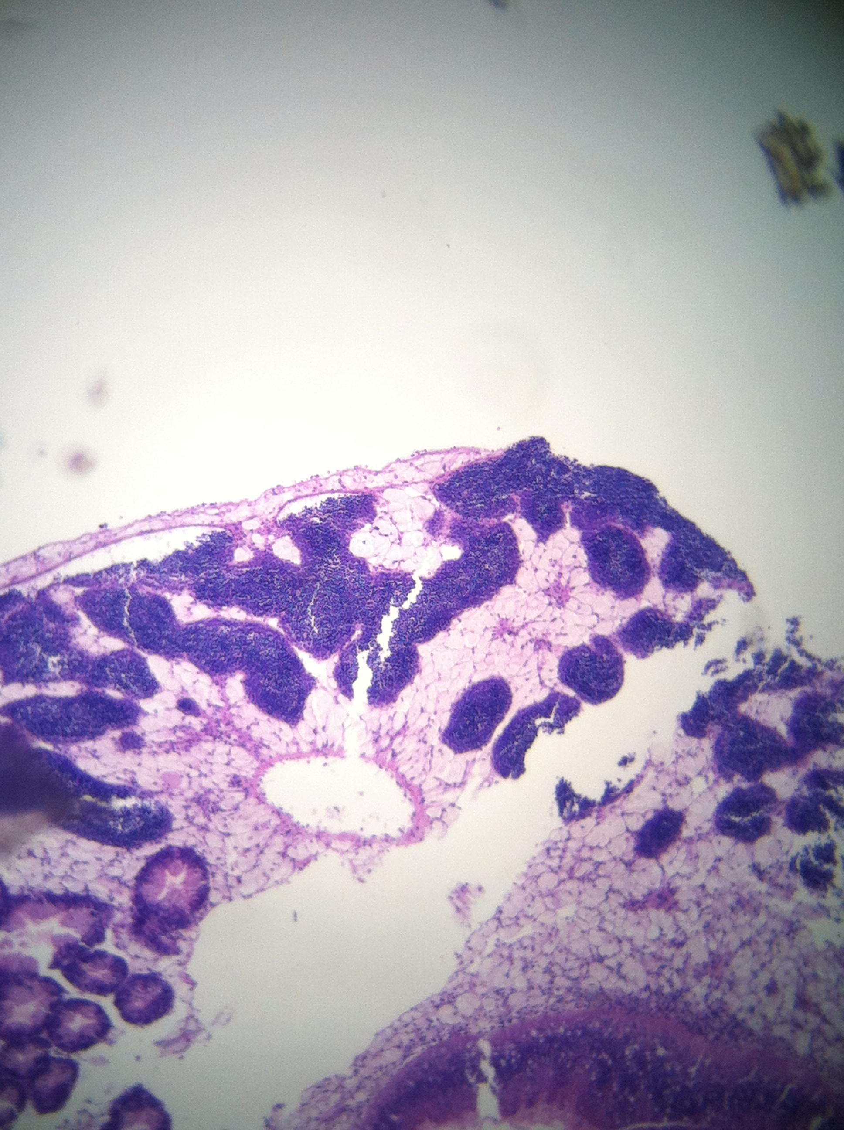
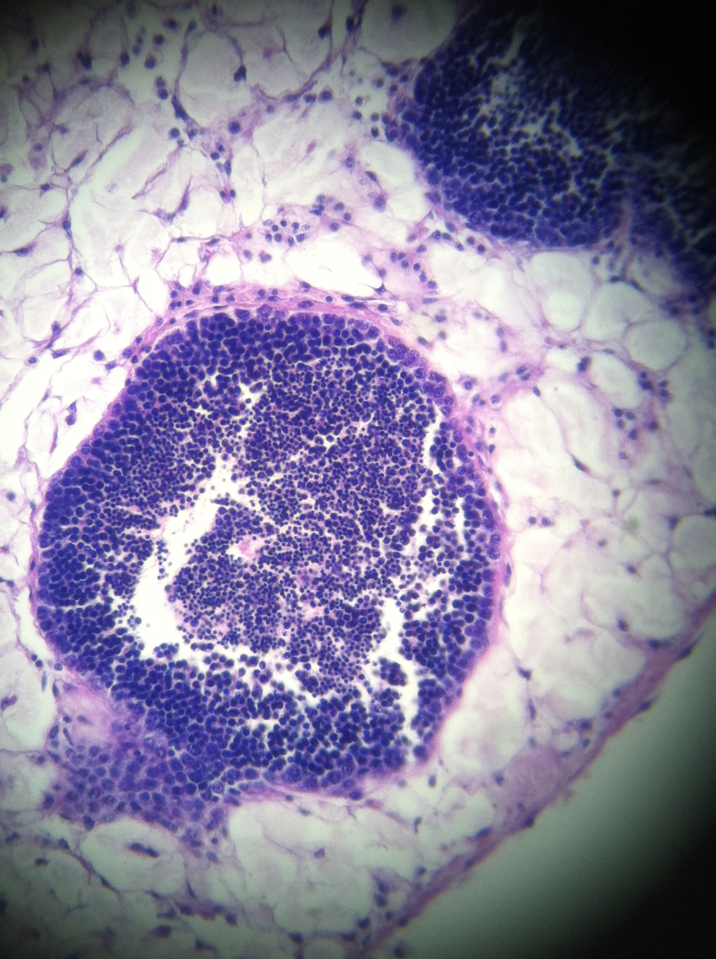
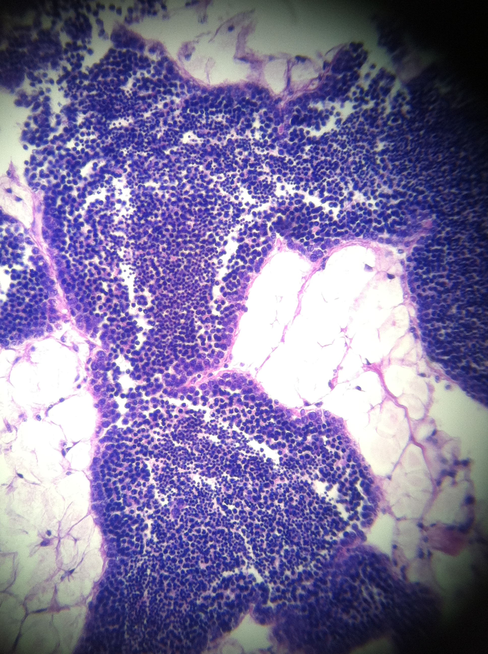
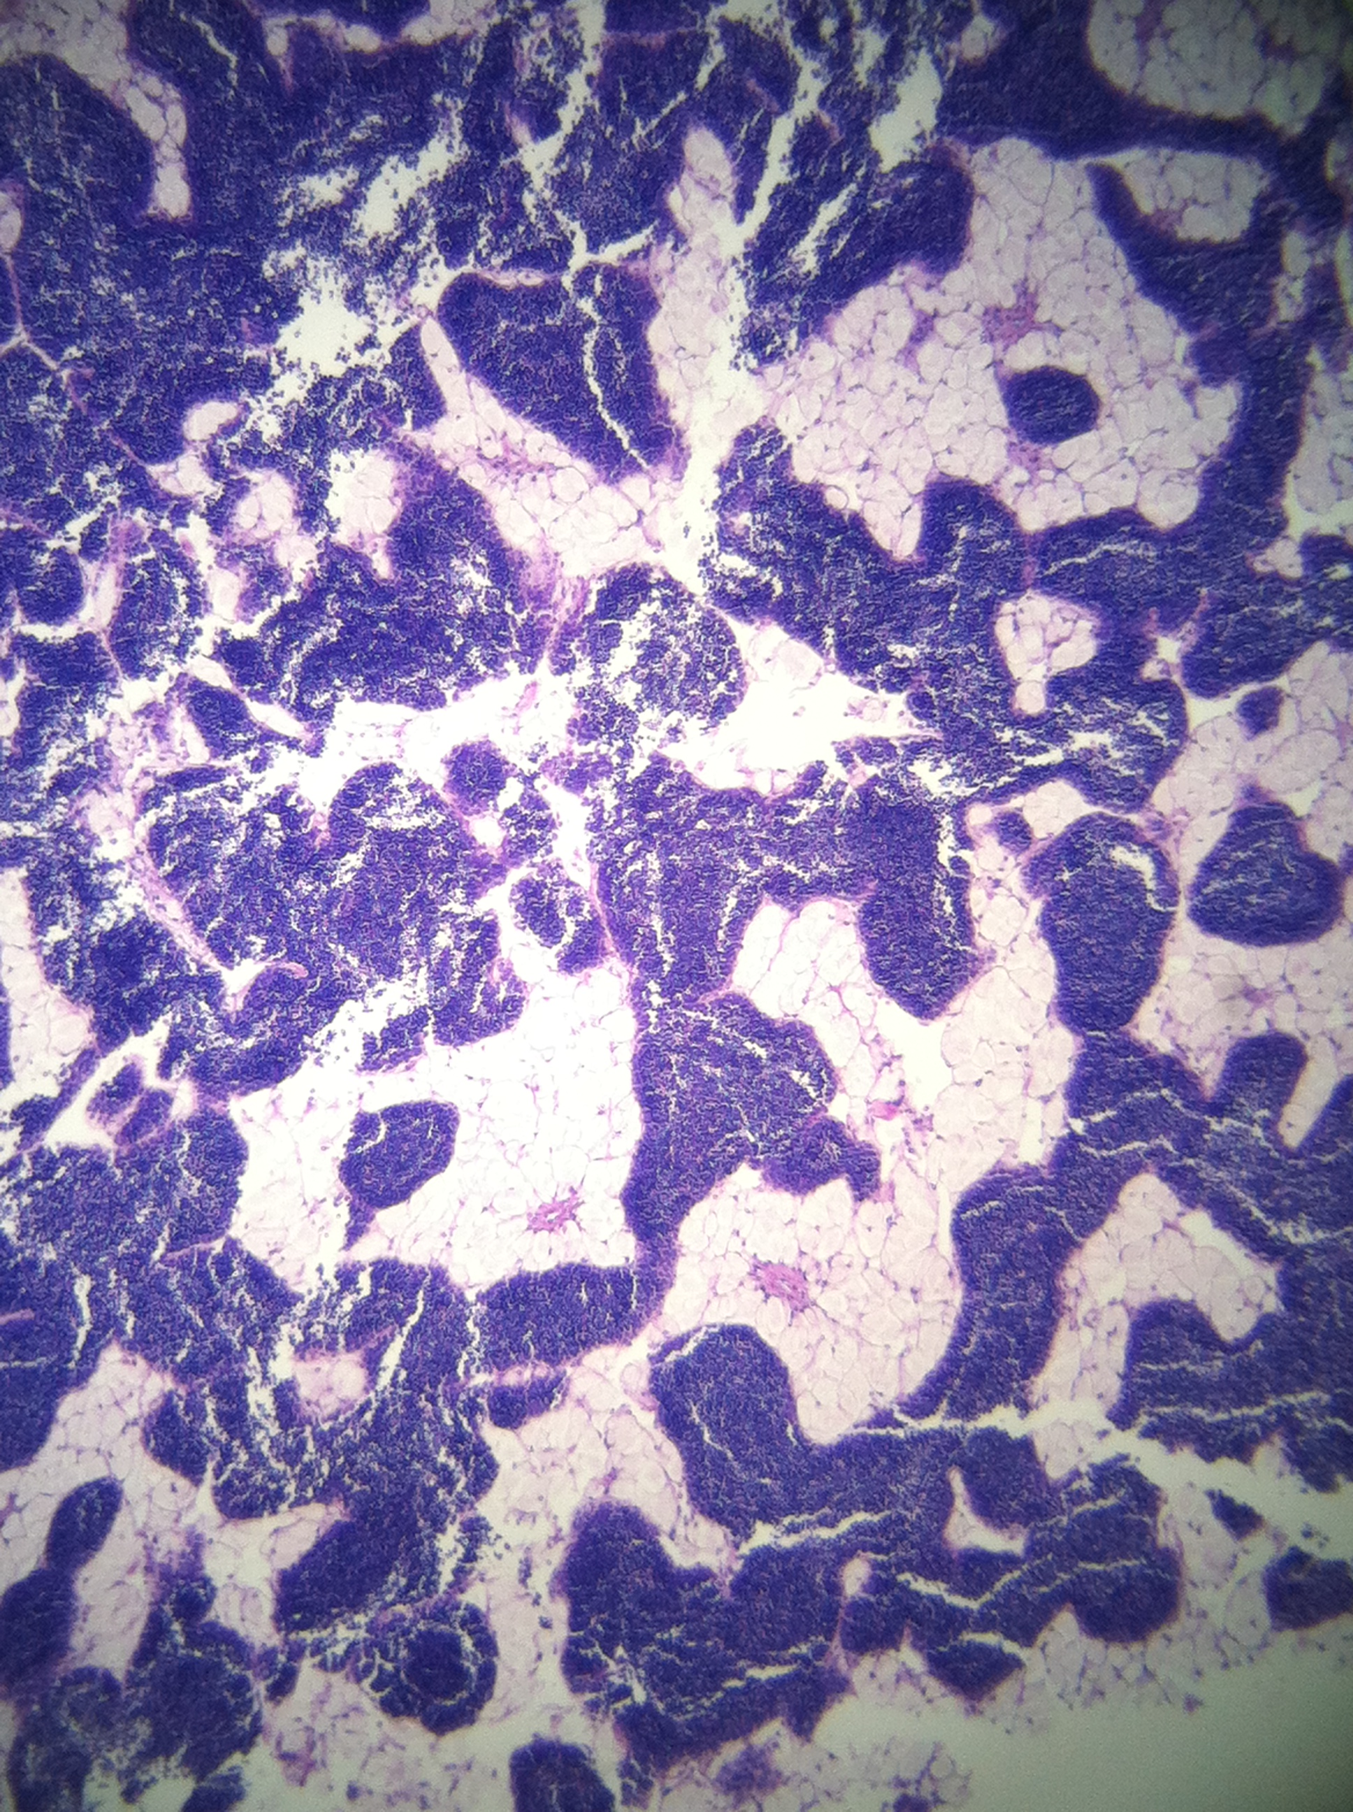
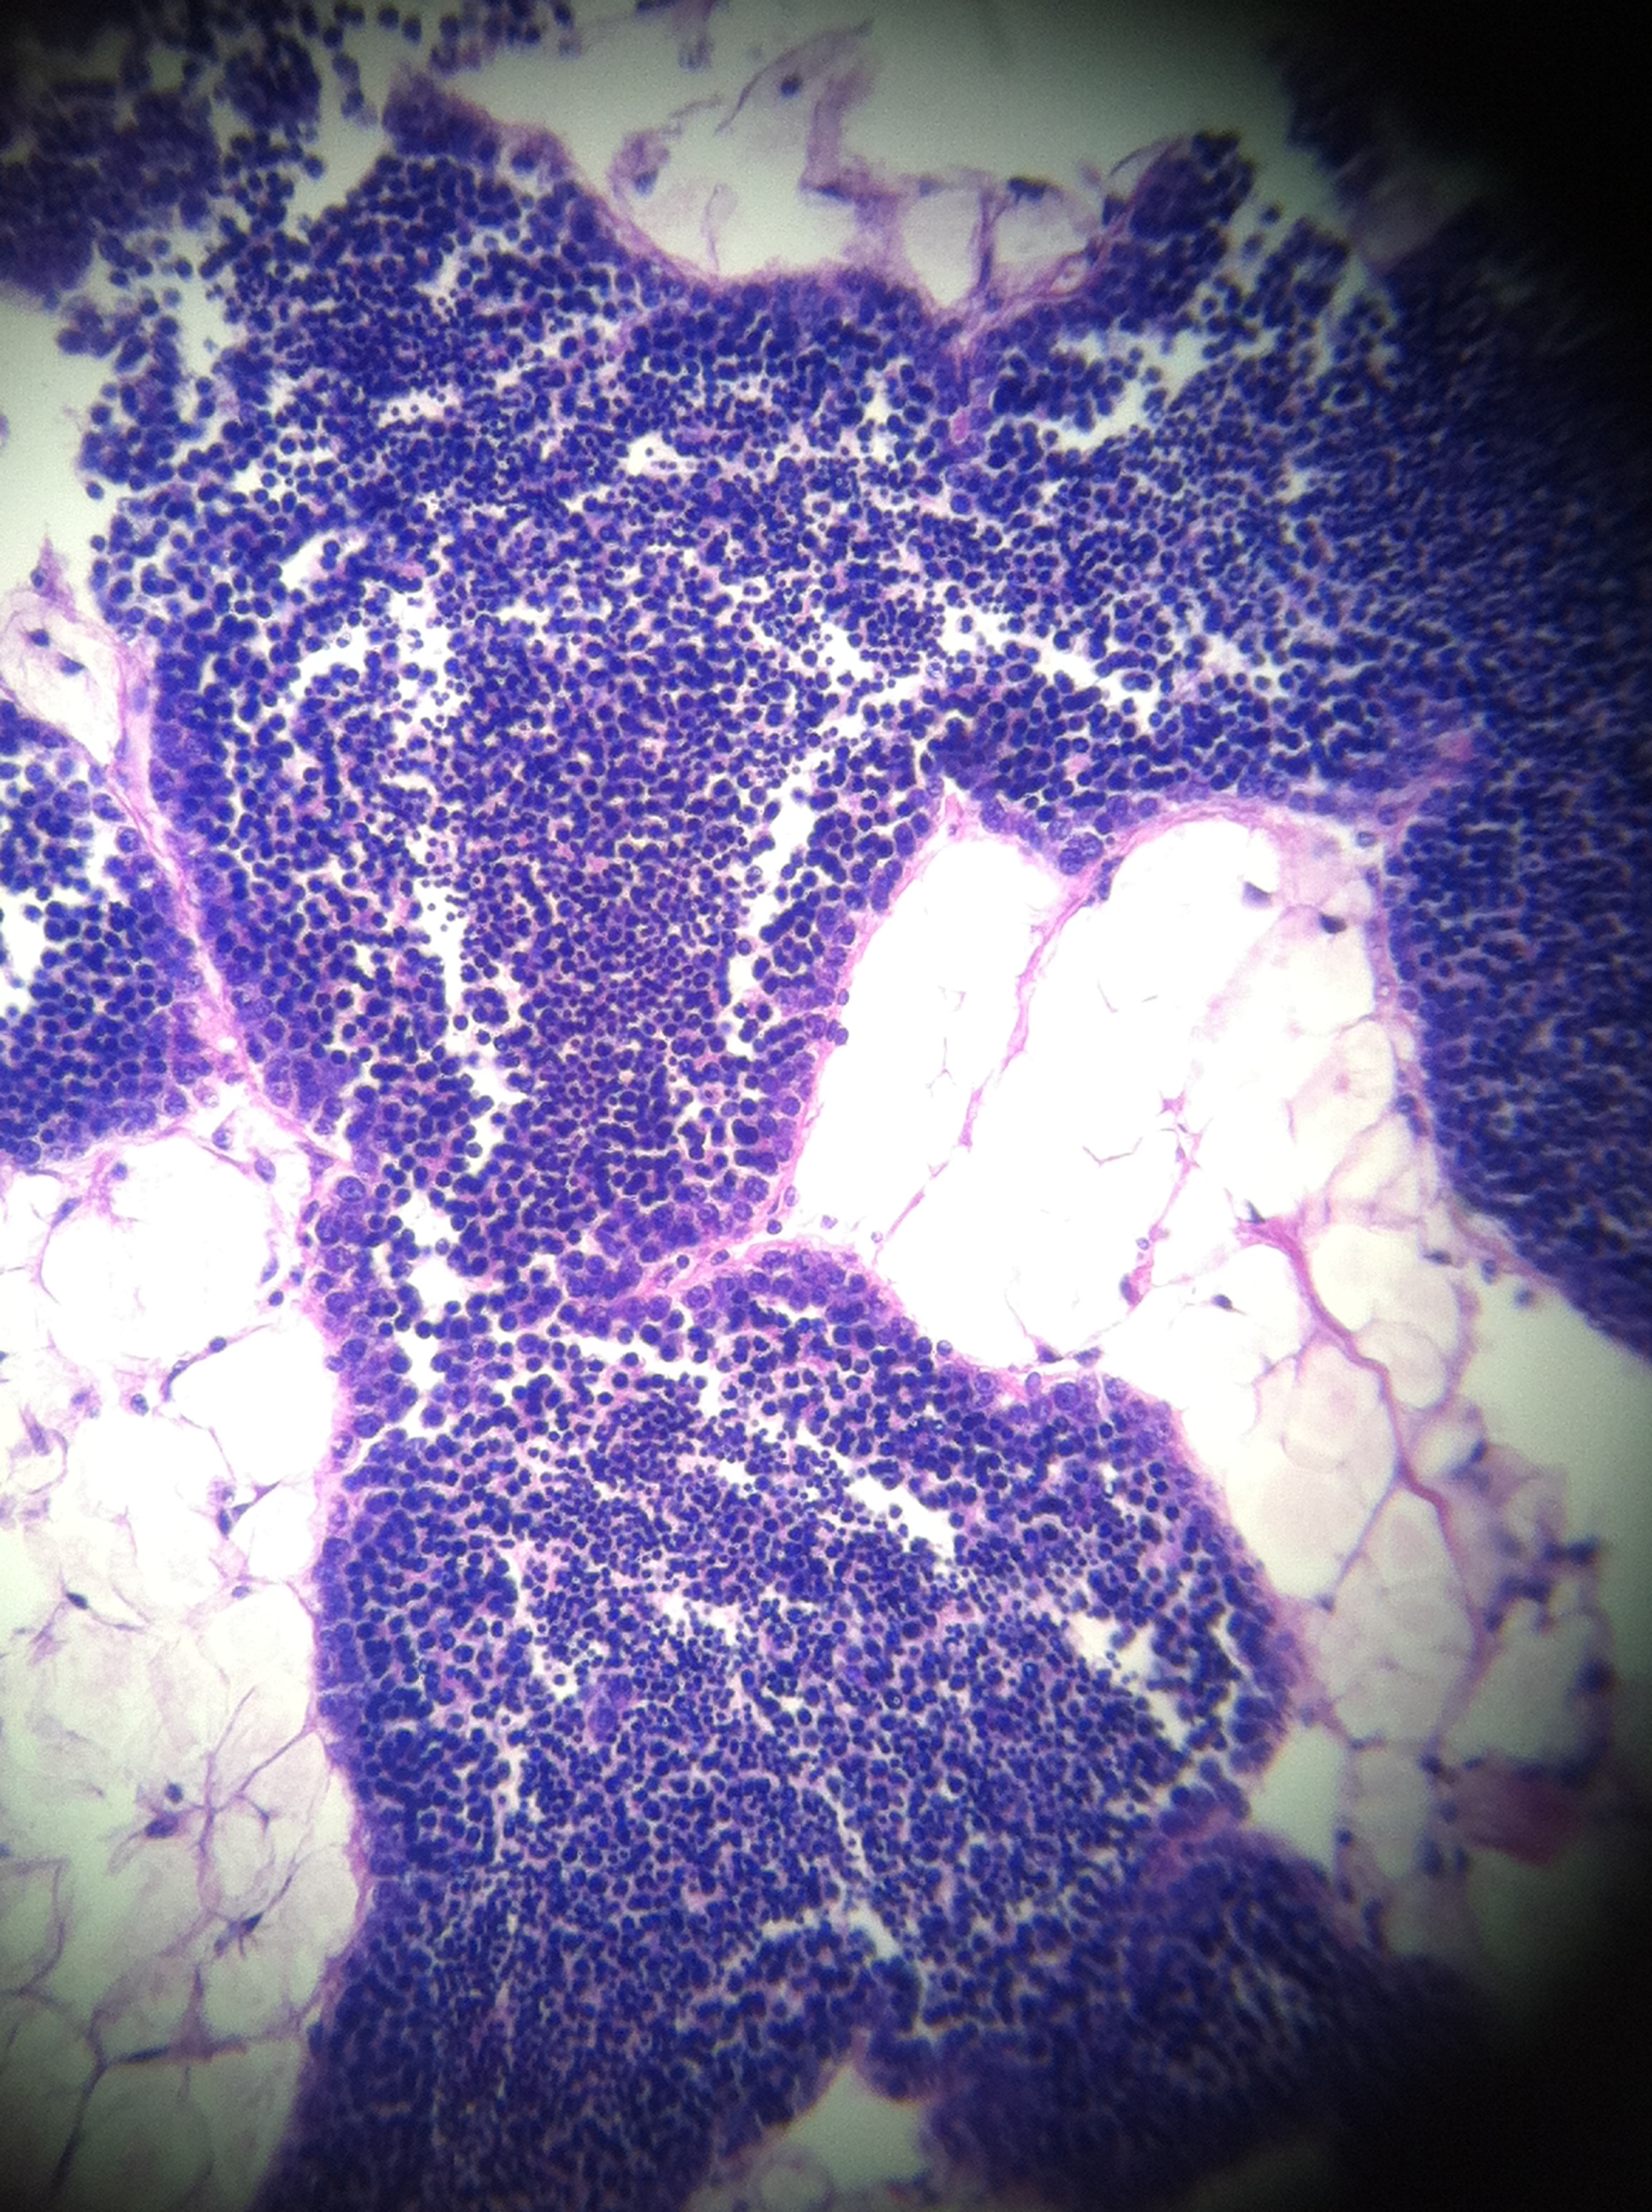
R363 - male
Stage 1 (early developing)
many small follicles
spermatagonia and spermatacytes
no spermatazoa

